Slide 1
The Doubling Cube…..
First introduced to the game around 1928-1930 in America.
Totally misunderstood until about the 1970s when we first find the concepts of double and take or drop, as well as pip counting in books. In fact as we will quickly see, that the statement found in one book from a leading author in the 30’s who stated that “should a correct double be offered, then it would always be right to drop” is totally nonsense.
By means of an answer to a question “what is the doubling cube used for?”, there is a leading American professional backgammon player called The Vermont Bear, who uses the catch-phrase when offering the cube to his opponent….”Let’s go visit Mr More”. That is in a nutshell what it does, it makes the game value more, double what it was originally being played for, if accepted. That is to say that a value of 1 would become 2, a game value of 2 would become 4 etc.

Slide 2
Apart from doubling the value of the points on offer, it can also be an effective way of “cashing” the game, taking the points on offer and not having to play the game out to completion to secure the available points haul.
An important point to remember, though, is that initially the cube is available to both players, and as such, both players in turn should always use the mantra of…when it’s my roll, do I own the cube? If yes, do I want to use it? When the cube has been turned, the acceptance comes with a very strong asset, they alone can now use the cube, the original giver of the cube has no access to it, until if or when the new owner gives him the option of taking it back at its increased doubled value. In other words, the owning of the cube has cube value, and should never be given up lightly.

Slide 3
The other important point to remember is that we play match play in our club, and that the cube is an extremely powerful tool in match play, and the nearer you get to the finishing line in a match, the more powerful the cube becomes, and can heavily distort cube actions, simply because of a match score. The explanation of each cube decision at all or various match scores is well beyond what I can show tonight, and for simplicity we have to consider everything as a Money game, that is to say that each game is a game unconnected to another, the decision to take or drop is based on purely whether it is right to take or drop, or double at all, based singularly on this one game.

Slide 4
So, by means of a few board positions, I hope to draw up some useful benchmark positions when evaluating cube action.
Don’t feel too upset if you play the computer with the doubling cube being used, it will never double when it is not right to double, you will, it will never miss the chance to double when it is right to double, you will, it will never accept a double when it is wrong to accept the cube, you will, and it will never drop a cube when it is right to take, you will. Let’s see if we can do better than blindly guessing the correct decision, i.e. not relying on pure luck. Let’s apply a bit of skill…….

Slide 5
There is nothing new or revolutionary in these notes, the following
positions are simply demonstrations of the various “rules” and any rule is a
very useful tool when deciding the doubling and taking decisions. Most positions
are very difficult to quantify winning chances, and years of experience, along with
pattern recognition will pay dividends, but these should act simply as a good
starting point to the basics of cube action.
The 8%, 9% and 12% “rule”.

Slide 6
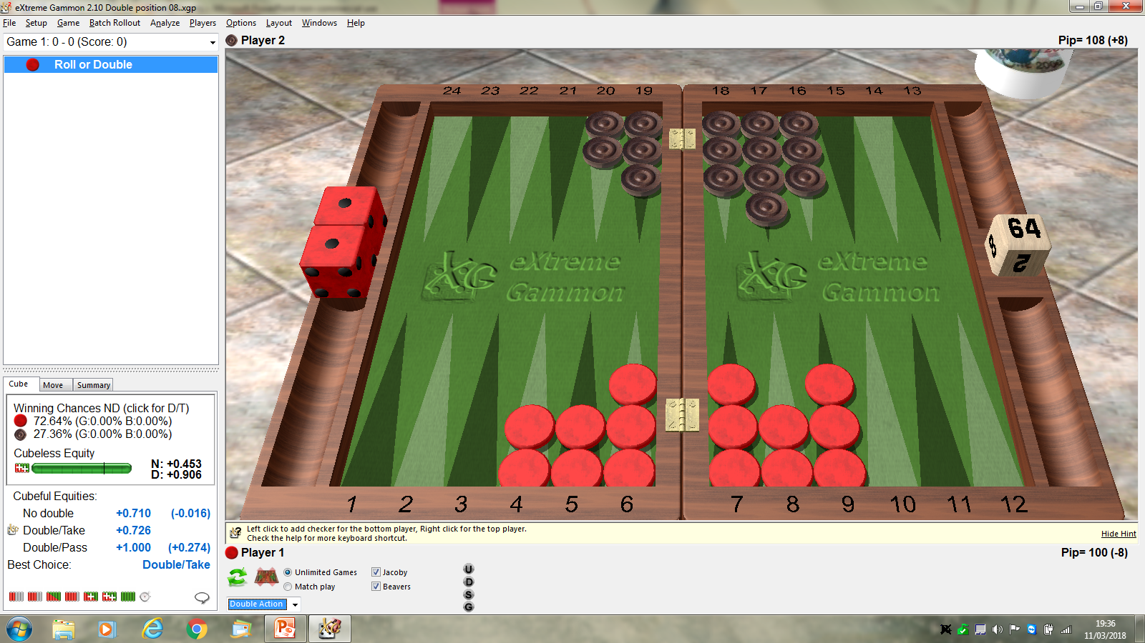
8% lead with 100 pips to bear all chkrs off. (And importantly, no contact remaining).
This equates to 72+% wins.
This is a marginal Double (just enough winning chances)/ Easy Take (well over 25% wins position).

Slide 7
We just need to explain why we refer to the 25% winning chance
as the minimum winning chance to justify taking a cube….
Assume we play a position 100 times….
Each time we offer the cube, and the opponent DROPS.
The one who cubed would win 100 points.
Now assume the one who cubed has a 75% chance of winning the game,
and in all 100 games, the one cubed TAKES the cube to a value of 2.
75% wins means 75 games won, now at a 2 cube equates to +150 points,
the 25% losses equates to 25 games lost, which equates to -50 points.
The nett result of the 100 games played, when all cubes are TAKEN
totals +150 -50, which is +100, EXACTLY the same number as if he
had dropped all cubes offered.
Obviously the higher the winning chances above 25%, the more points the
one cubed will win, and further below 25% will result in a bigger
nett loss situation, and so would do better by dropping everything below 25%.

Slide 9
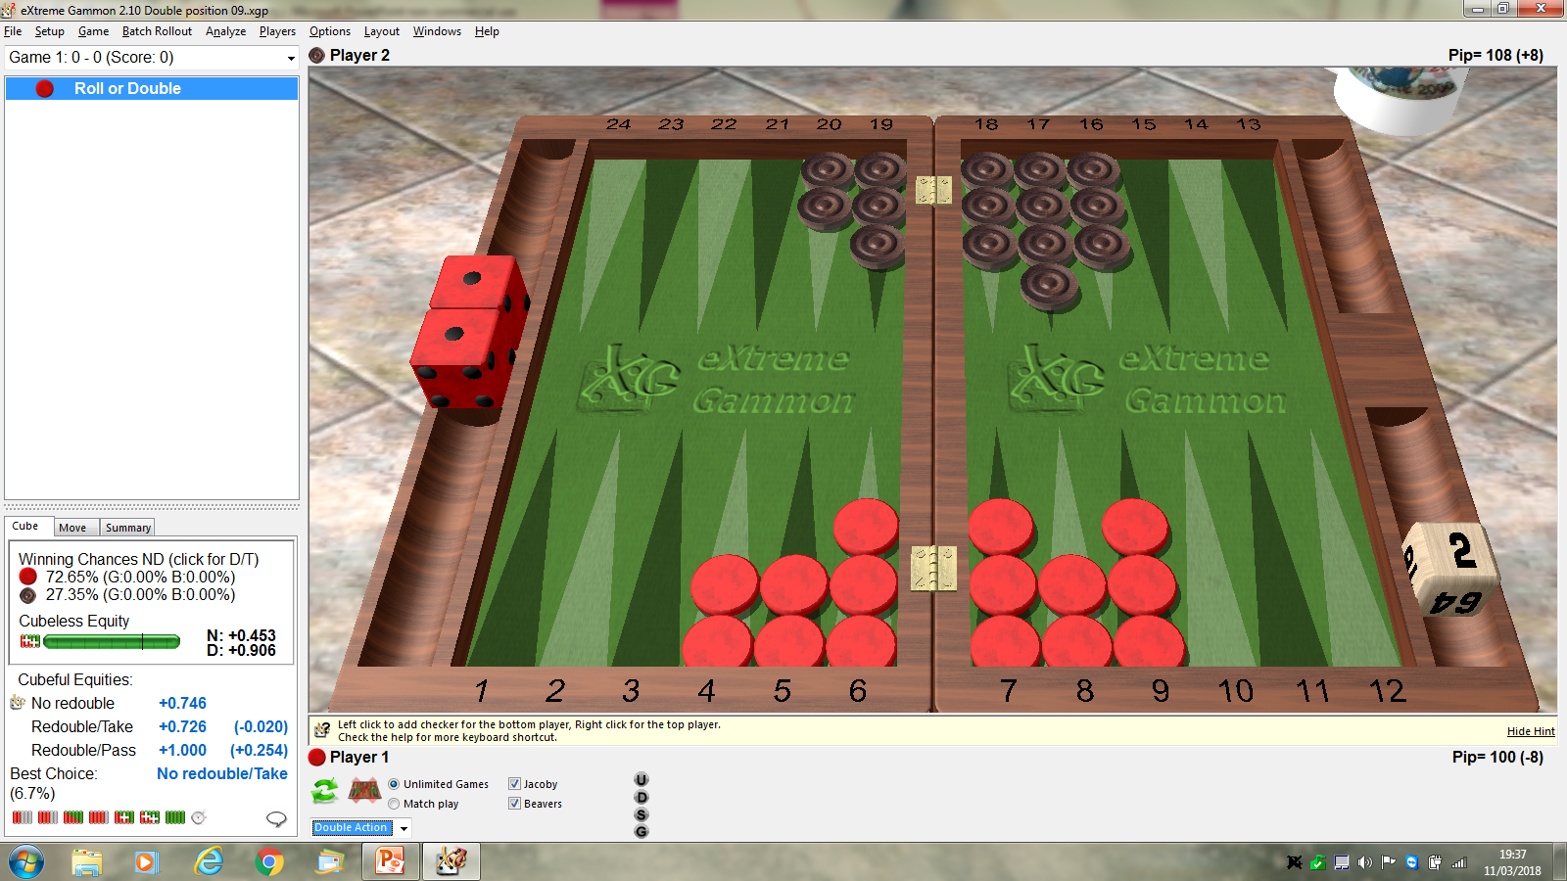
Again, 8% lead, but this time Red owns the 2 cube.
Now we see XG says “No re-double/Take”
By doubling the winning chances are obviously the same, but we will be
giving away a valuable asset.
So another bench mark, we need to get to more than 8%, i.e. 9% to recube.

Slide 10
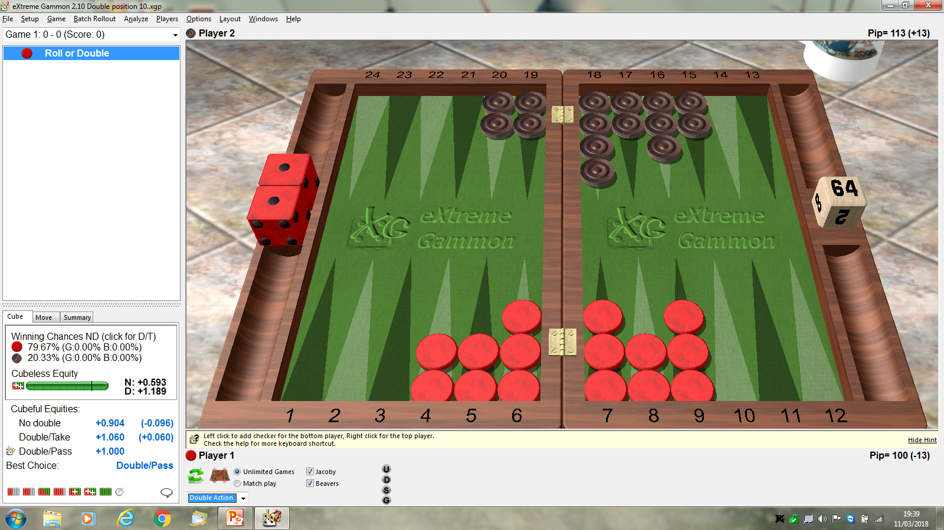
Red is now 13% ahead in a medium length race.
Red is now winning 80% of games.
We have reached the point where Black should drop the double.
12% pips lead in a medium length race is still a take,
13% is a drop in this medium length position.

Slide 11
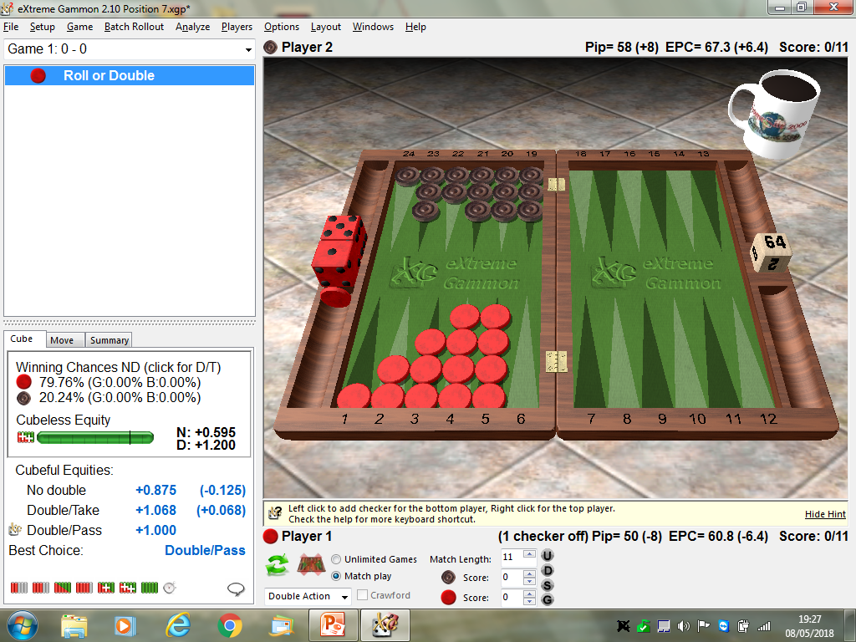
In our original slide, we had an 8 pip lead, 100 v 108 pips.
An average set of rolls later, perhaps 50 pips each taking maybe 7 rolls to achieve,
would result in the above position.
A player, not familiar with the rule, would arrive at this position, maybe the opponent
would spot the position as a drop, and a point gained for Red. BUT, the point is…..
Red has really lost 1 point by NOT doubling at the most efficient point, 50 pips
prior to this final position, only collecting 1 point when 2 was achievable.…..
Notes:
Reached point where double/drop is correct. But 50 pips before this stage would be…..

Slide 12
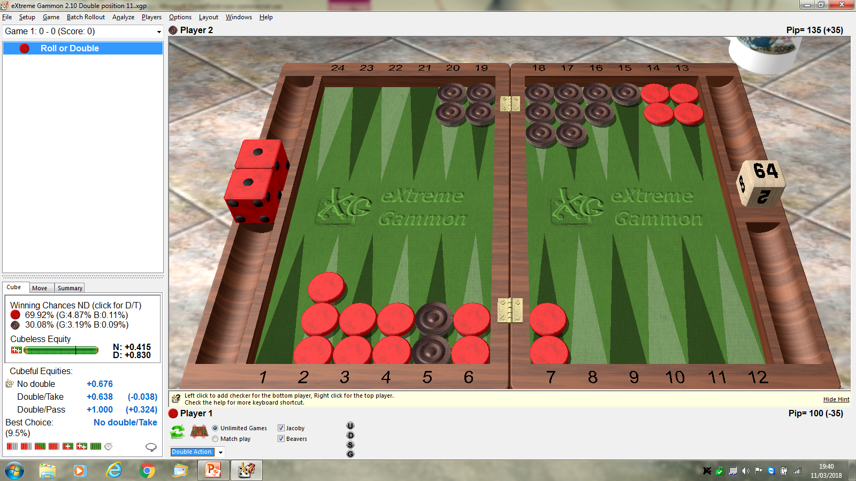
What are the significant features….
35 pip lead, 35% suggesting huge drop.
Black, anchored on the 5 point, leads to earlier hitting opportunities than the Ace point.
Red has 4 points in front of Black to clear, with no spare chkrs for flexibility.
Black’s deficit is in fact an asset, it means usually the home board is still intact, not crunched.
This all creates a No Double position, Black can win with a hit, and sometimes by racing.
2 small chances can often add up to more than enough to take.

Slide 13
Some more reference points to aid in cube decisions…..

Slide 14
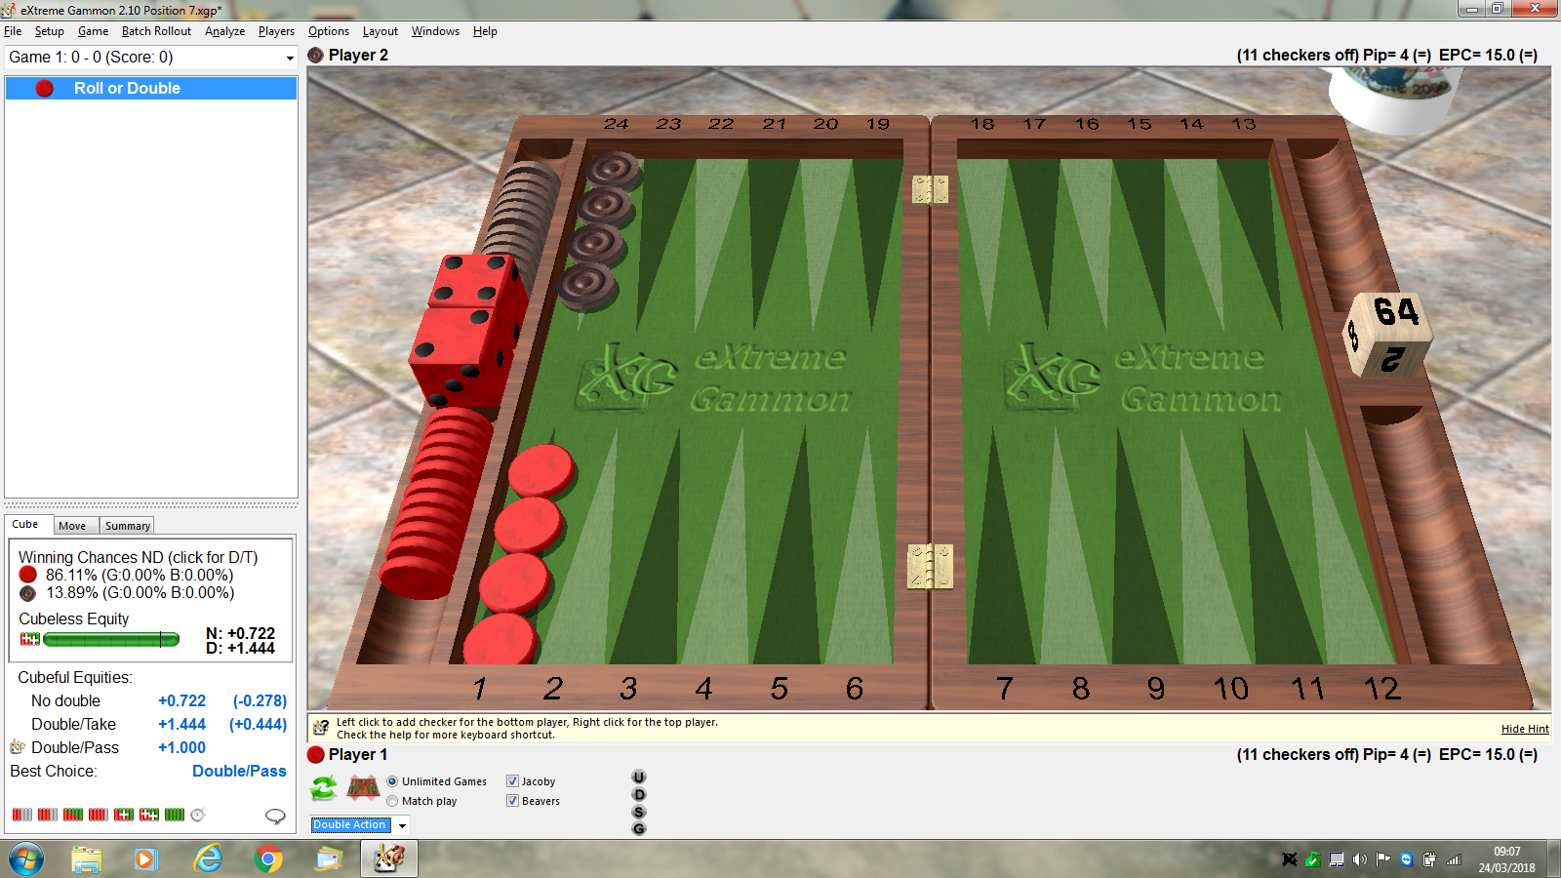
This is a classic 2-roll situation.
Black can only win by Red not rolling a double, and then Black rolling a double on his 1 roll.
This happens…30/36 x 1/6……simplified to 5/6x1/6 = 5/36, or approx 14%.
Red therefore wins 86% of the time, and Red Should Double, Black Drop.

Slide 15
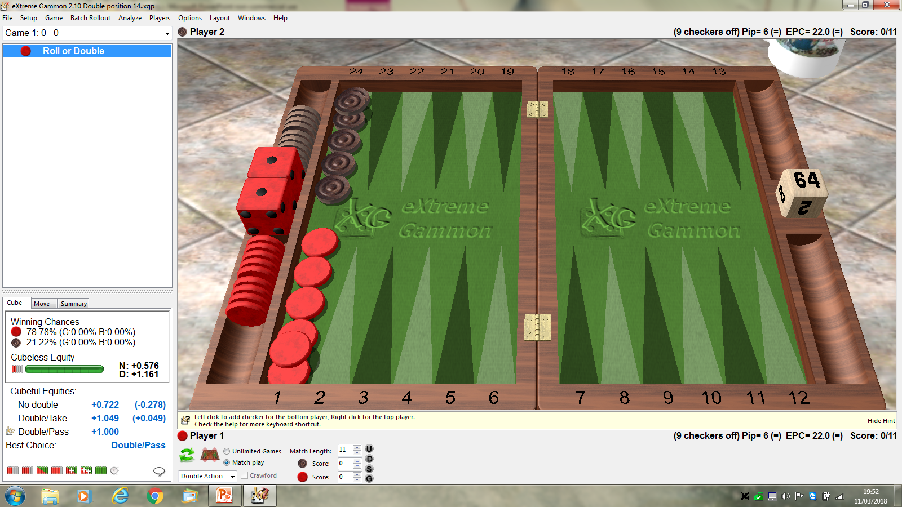
3-roll situation, Black has only 21% winning chances, so same result….Double/Drop.
Don’t ask me to show the maths to work out the 21%, but basically Red must not roll
a double in the next 2 rolls, while Black has to roll a double for Black to win from here.

Slide 16
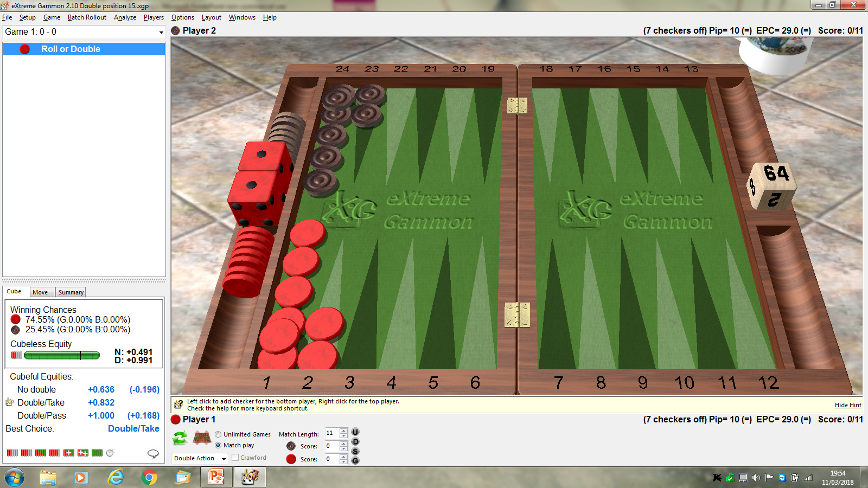
4-roll position, Double / Take. Very close to optimal position for Black to Take or Drop.

Slide 17
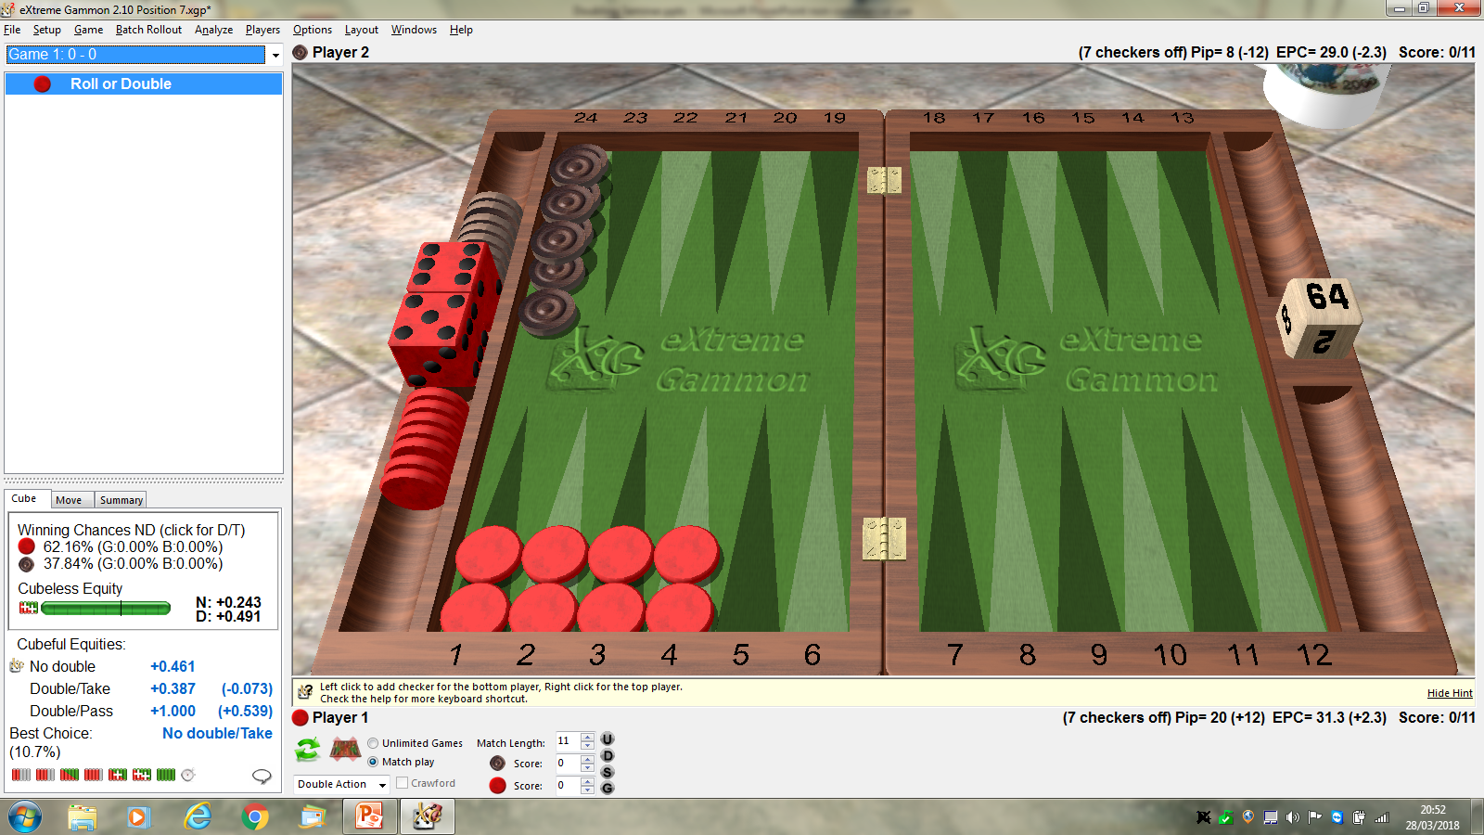
No longer a 4 roll position, Red can become the underdog with several bad rolls.
The 4 roll doubling relies on full use of doubles and low rolls, here 2-1 rolled twice
in a row for example will leave Red the underdog from there.
The small doubles fail to remove 4 checkers, a vital part of the position.
Summary…No Double /Take with only 62% winning chances for Red.

Slide 18
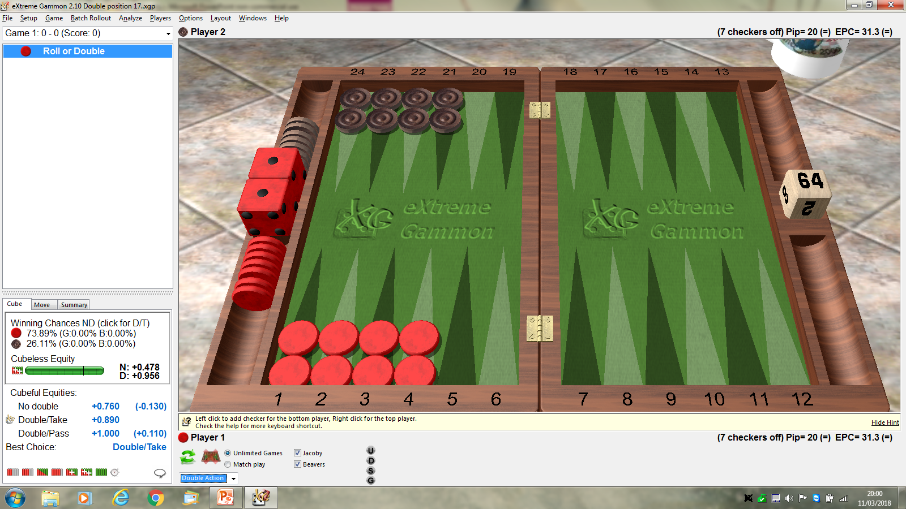
4-roll /5-roll, as both sides have weaknesses from their optimal chkr positions.
The weaknesses on both sides cancel out, and we return to a D/T, with 74% wins.

Slide 19

Sorry, couldn’t help myself, just a little dabble into match affected scores……
The same position, previously a D/T, becomes a D/Pass at 2A-2A ie 9-9 to 11, 3-3 to 5 etc.
This is because Black’s winning chances are 26% in the game, BUT…..
At 2A-1A Black’s match winning chances are 30%, so best to drop and start another game..

Slide 20
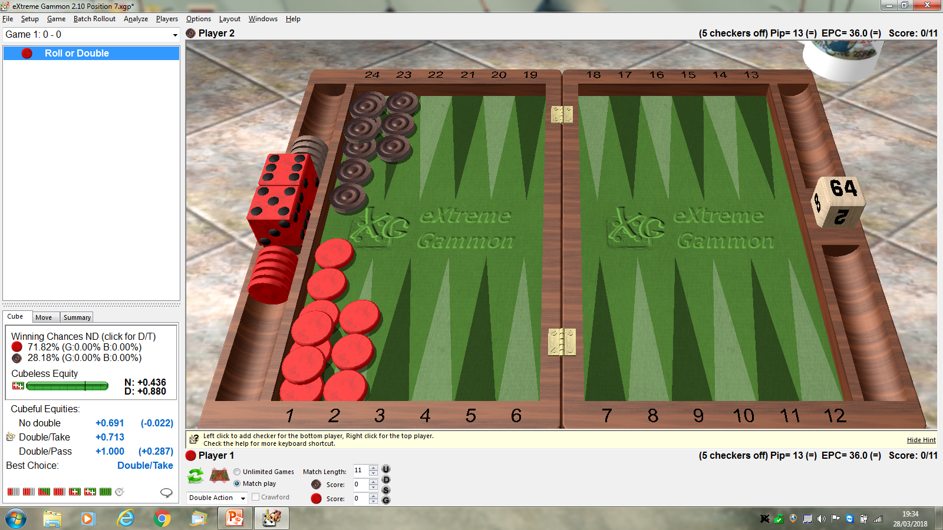
5-roll position. Black’s winning chances are improving, well above the 25% take point.
Just over 25% for a 4-roll pos’n has now risen to 28% winning chances, and an easy take.

Slide 21
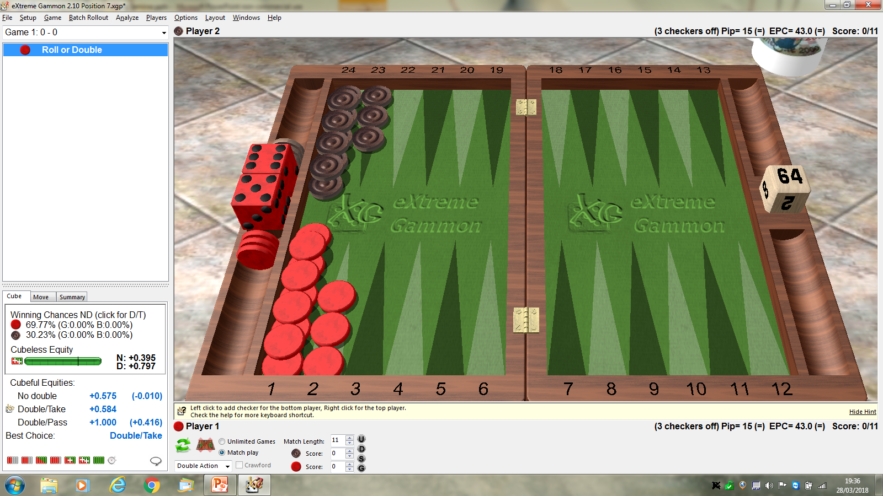
6-roll position, getting better for Black all the time, now it is only Just a Double/Easy take.
Red now wins less than 70%, and plenty of opportunities for Black to roll one of his doubles he needs.

Slide 22
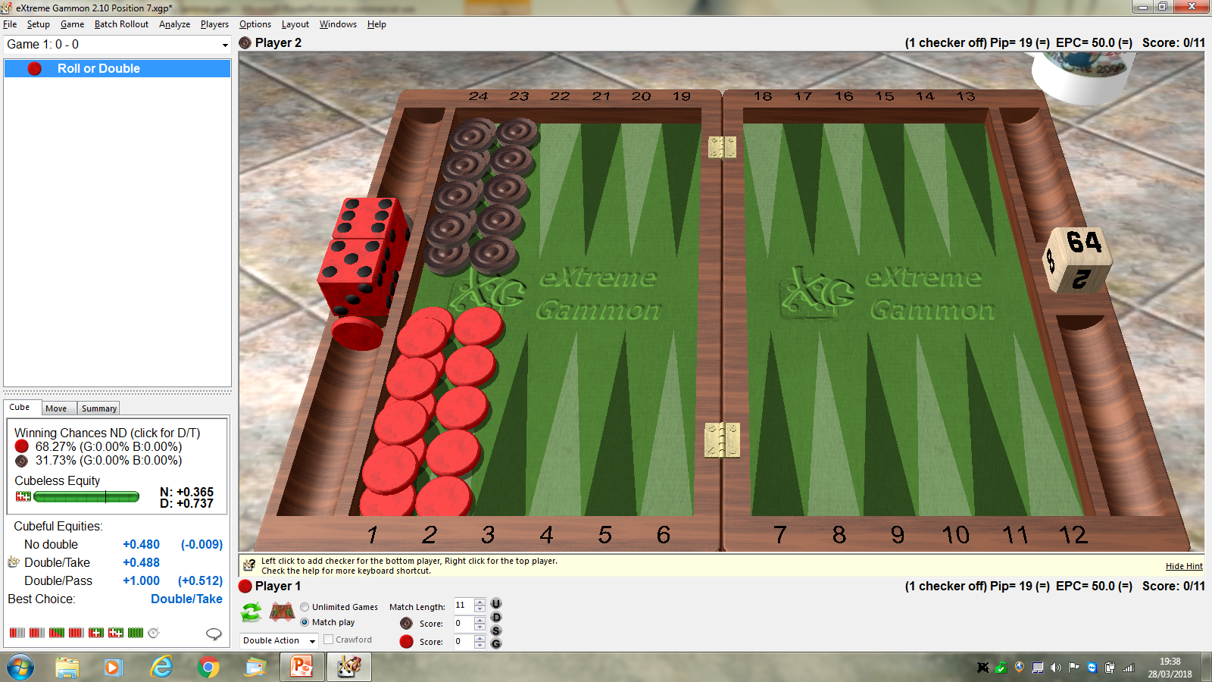
7-Roll, and now we have reached the point where Red is gaining nothing by doubling.
68% wins for Red, and only the 3rd decimal point separates Red’s equity with No Double,
and equity after doubling. Black therefore has massive gains by Taking the 2-cube, if offered.

Slide 23
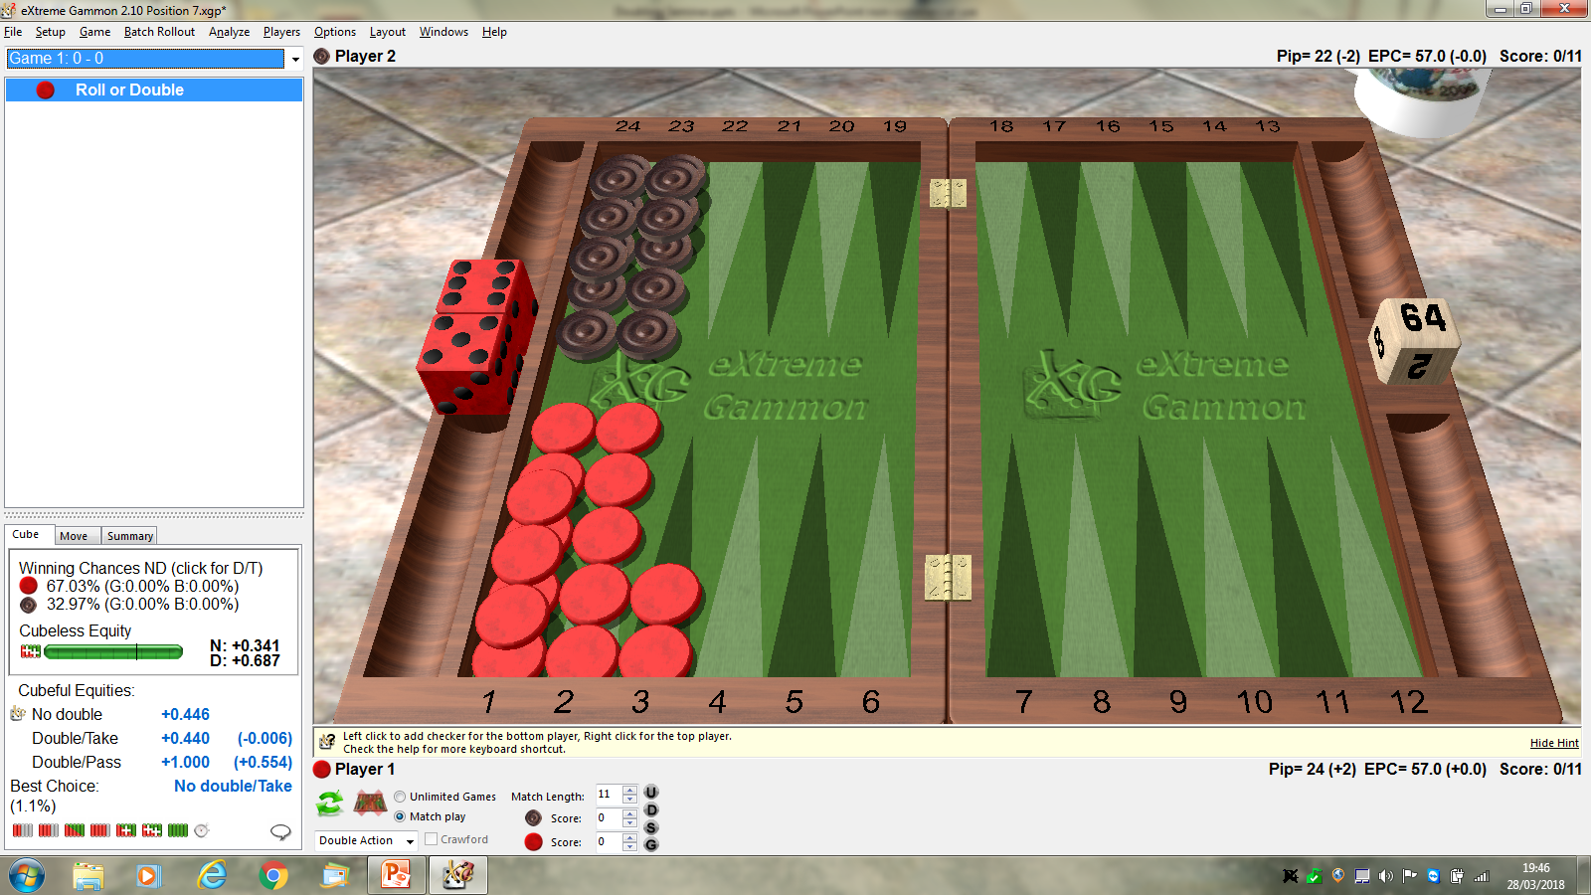
8-roll, and don’t part with that cube.
Easy take, of course.

Slide 24
a
The PRaT test.
P is for Position, what structure is good about your board, compared with the opponent’s?
R is for Race, never forget that Backgammon, despite all it’s complexities and subtleties,
is still a Race, the one who gets all his pieces off first, wins. Simples, as the meerkat says.
A is ….apple, also antelope and “and”
T is for Threat, what is hoping to happen next roll that would be wonderful
for the roller, and a big problem for the opponent?
If you use this mantra before you roll, if you are “up” in only 1 of these tests,
then it is likely that it is too early to cube the opponent.
If you are “up” in 2 of these, it is highly likely that you have an effective double.
If you are “up” in all 3 categories, it may well be that you are too good to double,
and maybe should play on for the gammon. Note…in Money games, the gammon
win can only be achieved in games where the cube has been used.
Big note…never forget you are playing a human, if you know your opponent will
take anything, double or redouble and reap the rewards of an incorrect Take.

Slide 25
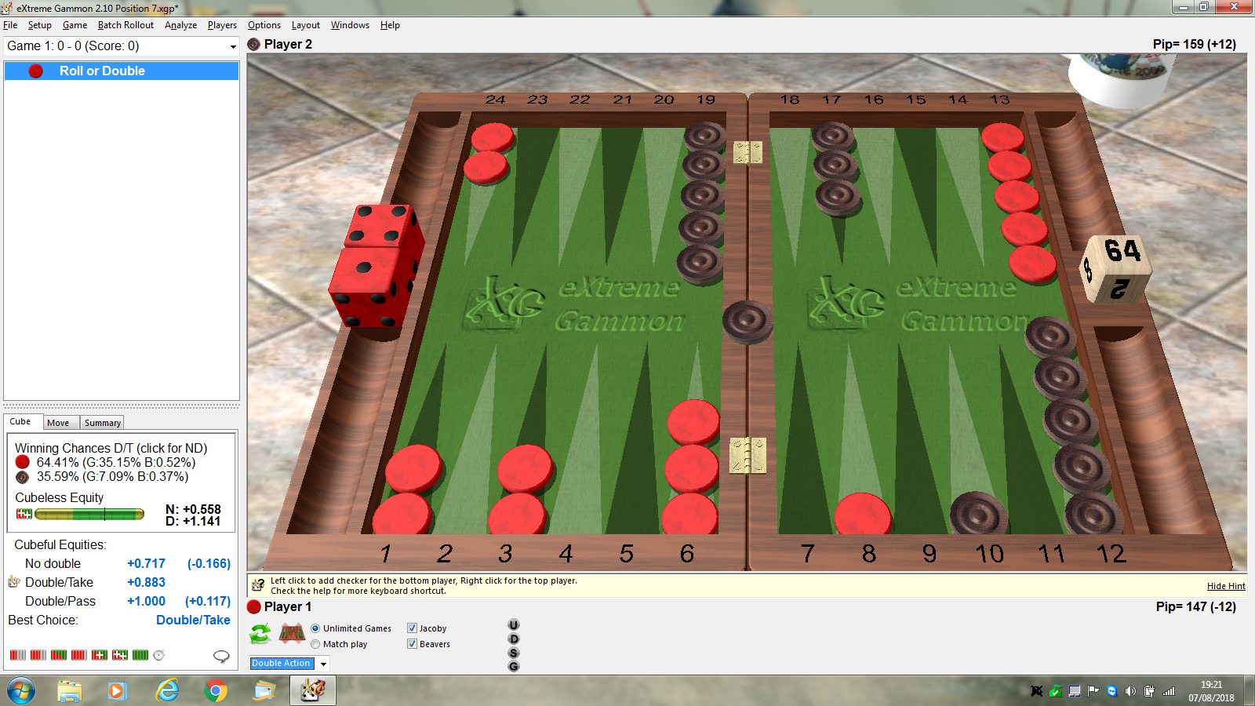
Likely sequence…Black rolls 6-3 and runs, 24/15. Red rolls 5-5 and hits, Black dances.
Using our mantra, P for position, 3 pt home board v 1 point board. Up in 1 category.
R for Race, up 12 pips, not huge advantage, but useful, so not enough to count as Up in 2.
T for Threat. Attacking another blot, but not a done deal, only 13 rolls hit it.
This turns out to be a good reference, good enough to double, good enough to take.

Slide 26
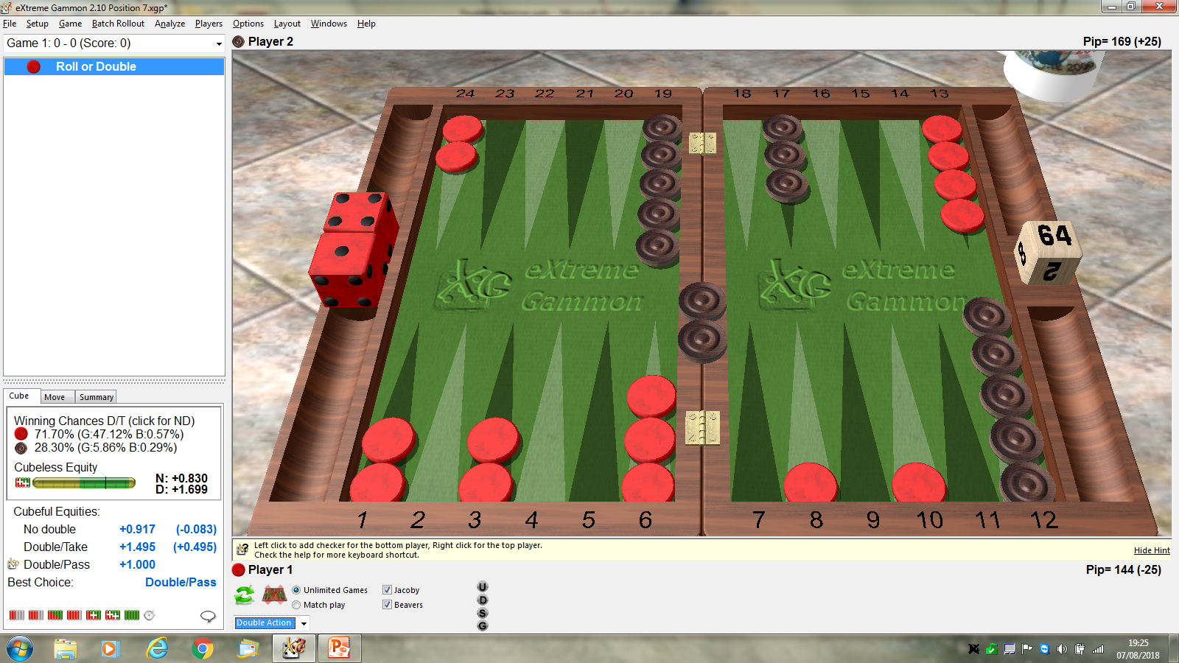
Red didn’t double (an error we know), then he got lucky and hit the 2nd blot with one of his
13 rolls. Position is more strong for Red now 3 pt board, and 2 on the bar.
Race is unimportant, Red is Blitzing anytime Black enters with one checker til the job is
done, or Black rolls a useful double.
The threat of a 2nd chkr has now resulted in a threat to close out Black and win about
half his games as gammon wins. Black still wins 28%, but the gammons against are too costly.

Slide 27
Some more classic benchmarks to “enjoy”.

Slide 28
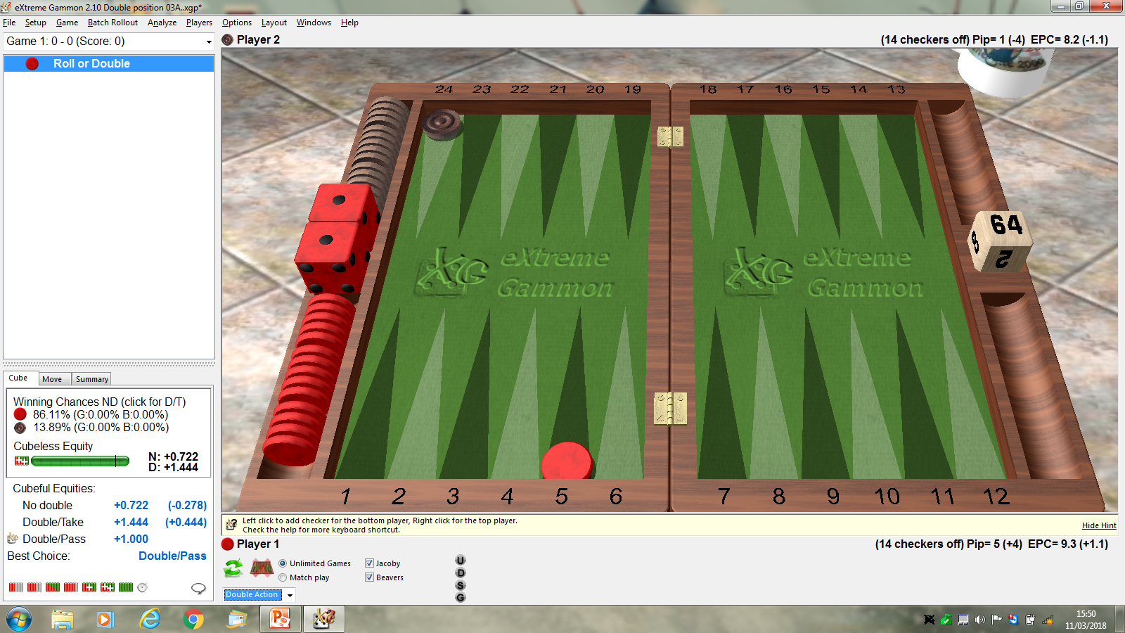
Easiest is to count the rolls that Fail to bear Red off.
Answer is 5. The target is to have 9 or more bad rolls for Red, to get Black to his 25% take point.
This equates to 86% winning chances.
So we know the cube action don’t we…….D/P.

Slide 29

Getting harder for Red, now how many rolls fail to bear Red off?
The answer is………9.
This means that Red wins 75%, Black 25%.
Black could use a coin and flip for take or drop……
Obviously Red should double, being better than 50% chance of winning the game.

Slide 30
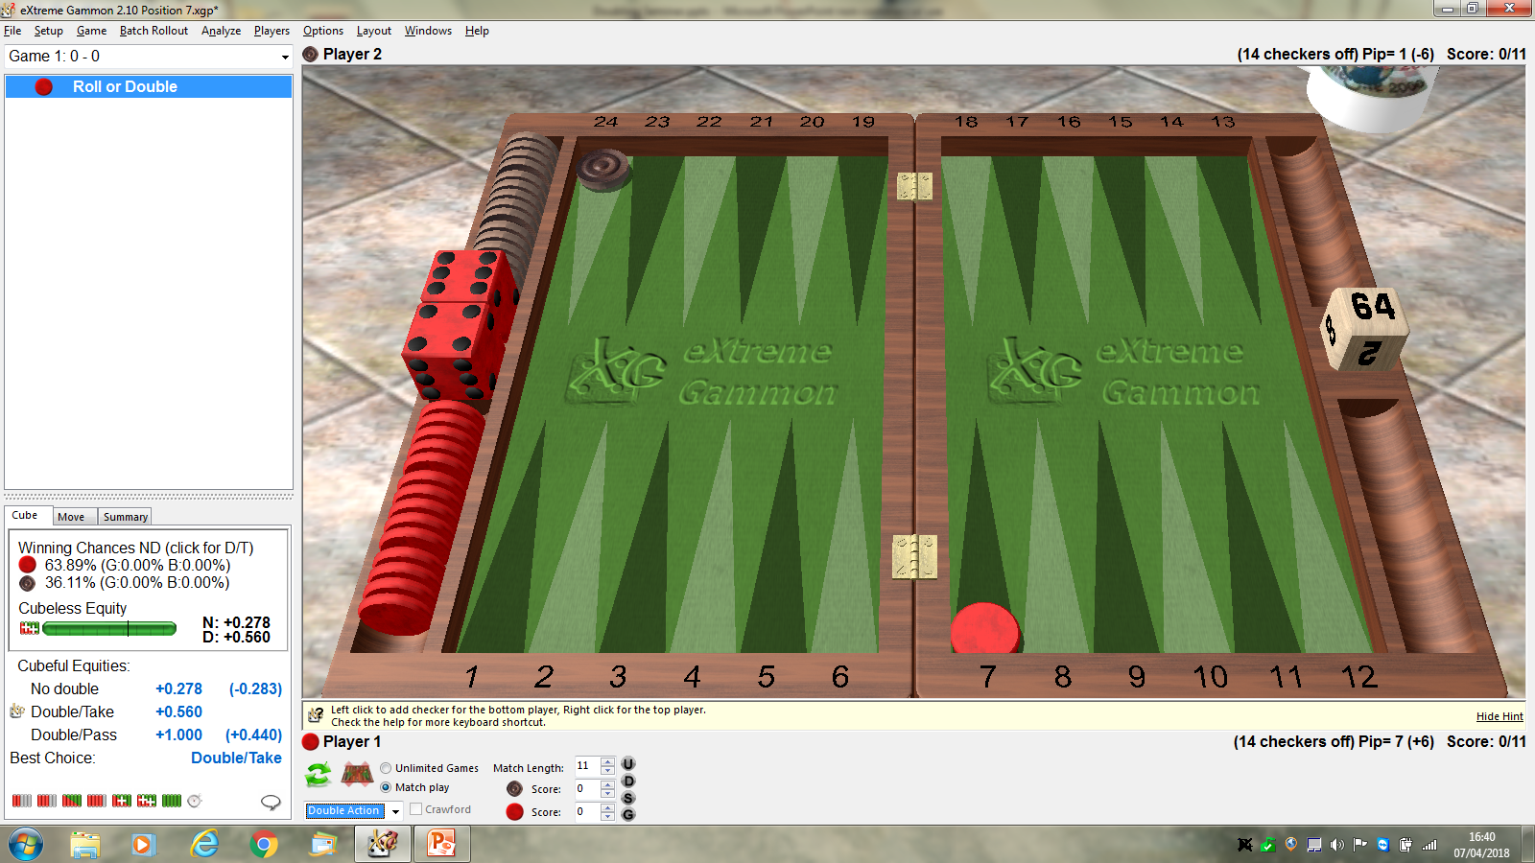
More counting…..how many rolls fail to bear Red off?, remembering that 9 signals a Take.
Hopefully found them all…..13…..D1, 2-1, 3-1, 4-1, 5-1, 3-2, 4-2.
Now Black should know that equates to 36% winning chances, so he Takes,
Red doubles of course.

Slide 31
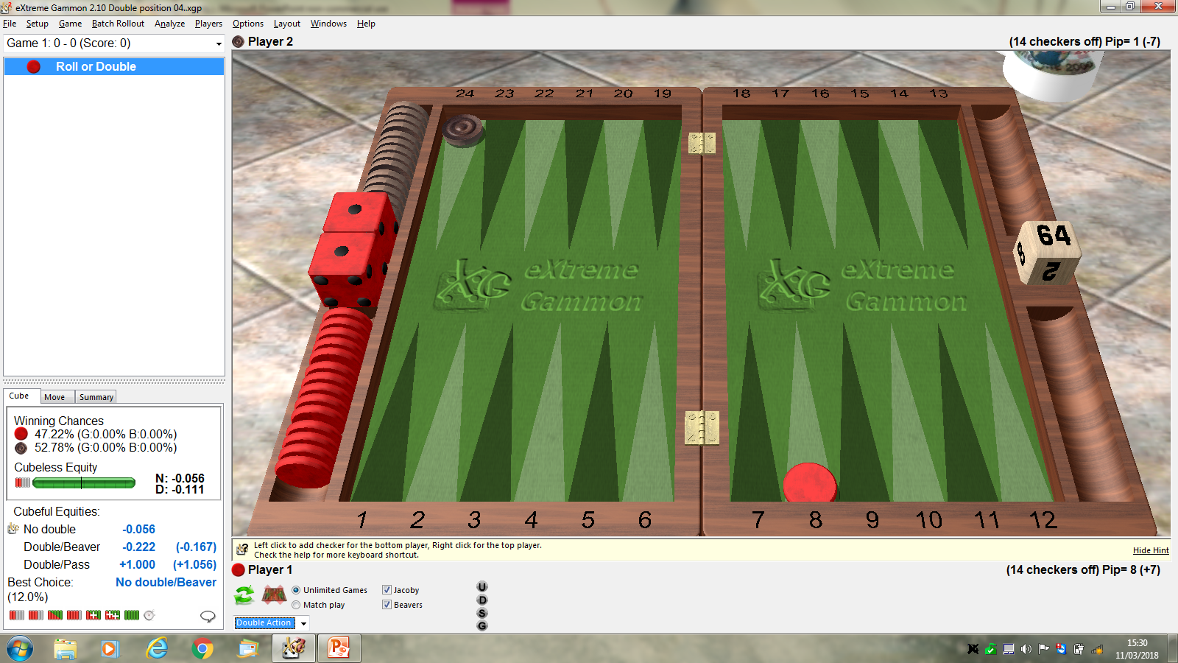
Surely more counting, you know the question to be answered, so I won’t ask it….
Paracetamol tablet time…..19 rolls fail to bear Red off.
So, now Red is not even a favourite in this position, less than half his rolls are successful.
We don’t play “money” games in the club, but if we did, and if Red did double erroneously
We have a “Beaver”…..Black would do better to accept the cube, turn it to 4 and keep the cube..

Slide 32
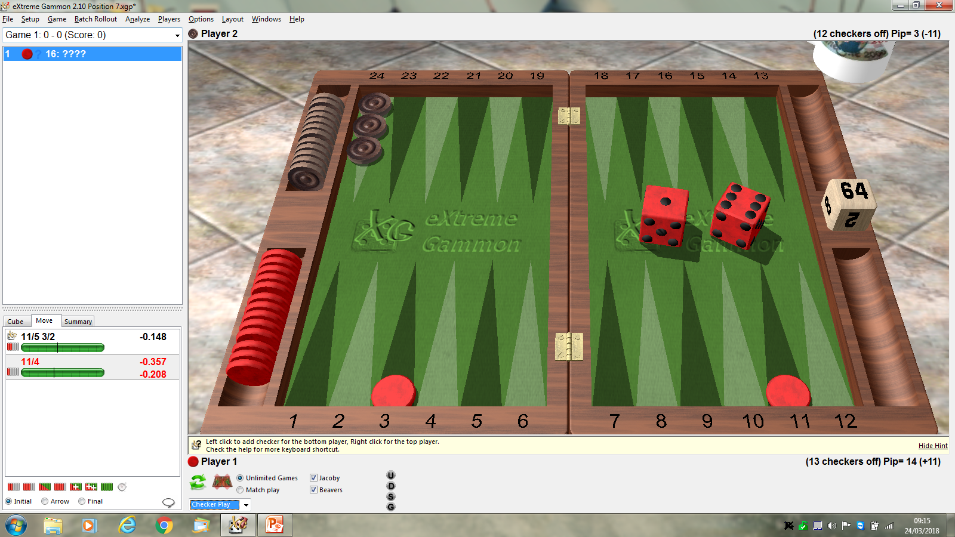
I’ve seen this misplayed serveral times on club evenings, and it is the case of putting the
2 checkers in the best position to maximise the chance of bearing both chkrs off next roll,
assuming Black doesn’t roll a double next roll.
If we play 11-5-4, we finish with the following position….

Slide 33

Does this look ok?
How many rolls fail to bear off for Red?
19 fails is not a good number, Red being the underdog, cannot double this position.
He has to roll and hope he doesn’t roll one of the 19 failing rolls.

Slide 34

Instead of 11-5-4, Red plays 11-5, 3-2. How does this look?
How many rolls bear off both checkers?
19 is a nice number, Red is favourite to win, he doubles, Black takes with 47% win chances.
There is a nice “aid” to optimalise checker placement, which we may have time to discuss.

Slide 35
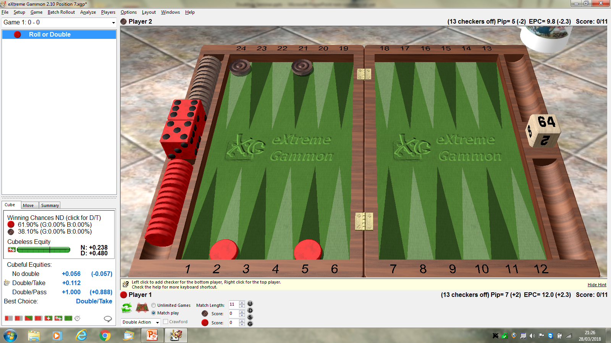
Red still has his 19 good rolls, Black looks worse now because he could fail to be off next roll.
Is this true though?
Black has 7 bad rolls, but this is Not a problem. Why not ?
Black simply redoubles to 4, Red sees he has less than the 9 rolls for 25% wins, drops the re-cube..

Slide 36
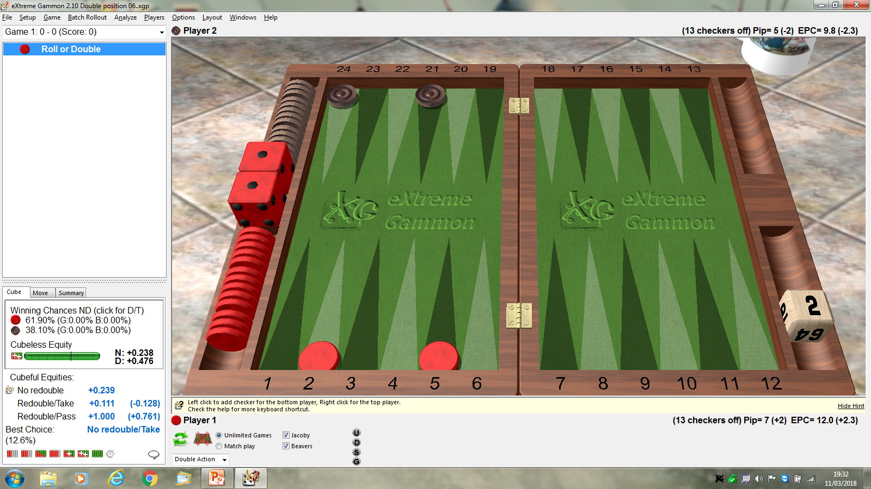
Now let’s give the 2-cube to Red. Does he have a re-double to 4?
The answer is surprisingly No. The problem is the re-cube by Black to 8 when Red fails.
Red would have to drop, but if he keeps the 2 cube, he gets more ways to win apart from
his initial 19 good rolls. He wins a further 7 times on all of Black’s bad numbers.
The maths are complicated, but recognising this as a case to hold the cube is very useful.

Slide 37
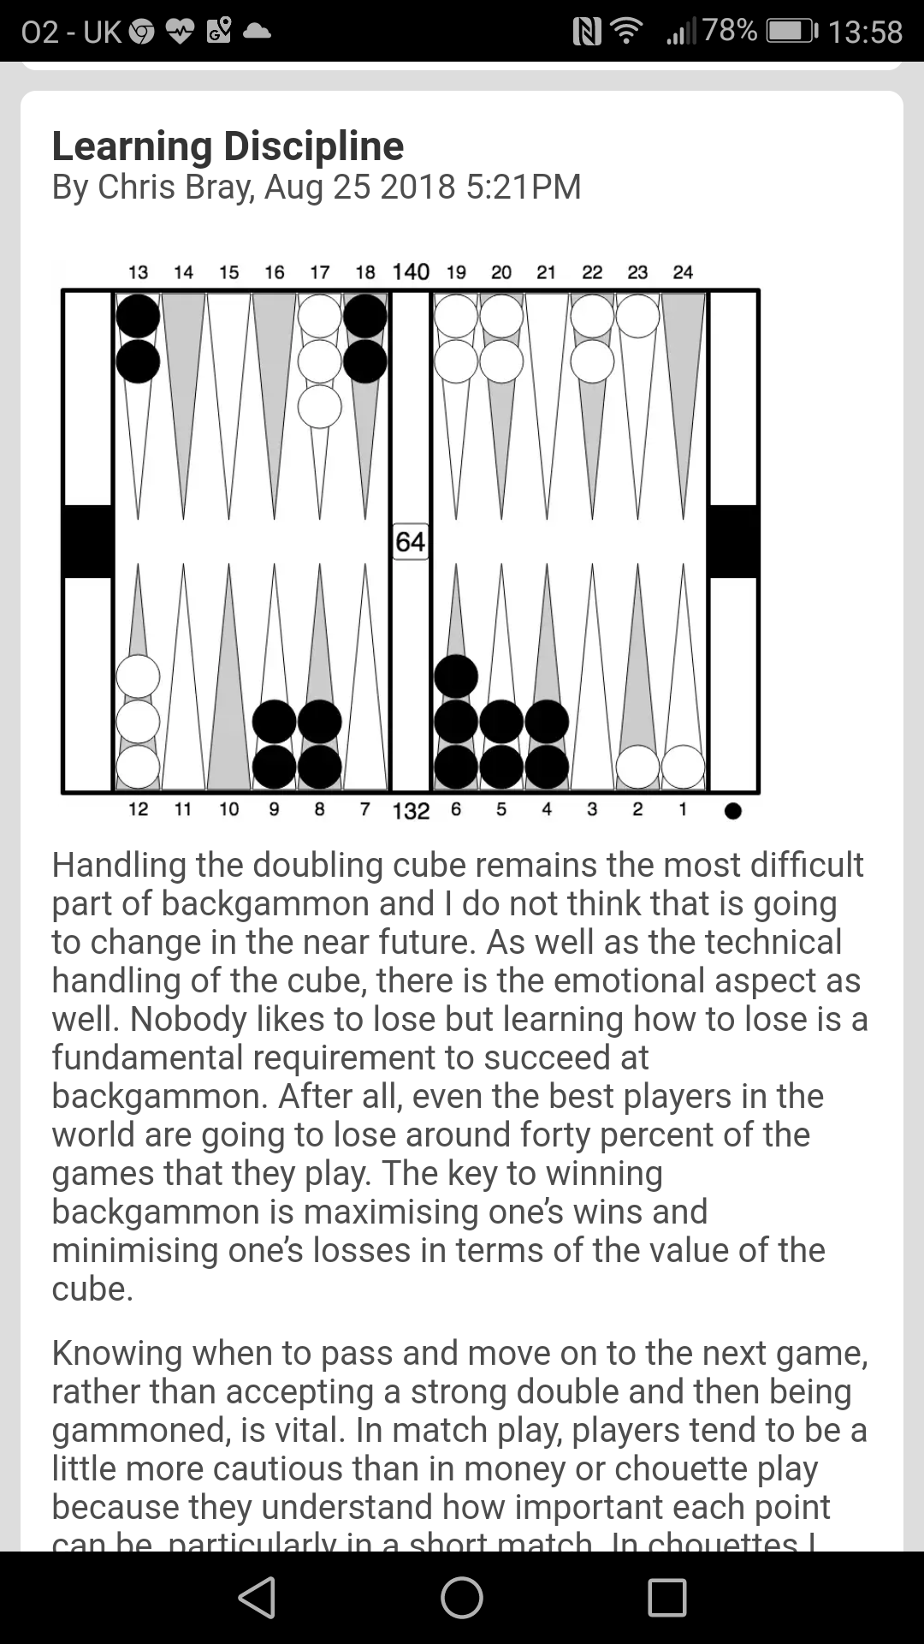

Slide 38
Knowing when to pass and move on to the next game, rather than accepting a strong double and then being gammoned, is vital. In match play, players tend to be a little more cautious than in money or chouette play because they understand how important each point can be, particularly in a short match. In chouettes I have seen some truly horrendous takes made, normally accompanied by a show of bravado. When the taker then turns around a game and wins he assumes it is his skill that has brought about the result and he will go on to take even more bad doubles.
Of course, one needs to be able to technically assess any position and then make the correct decisions as both the doubler and the taker. Beginners will necessarily flounder in complex situations because they just do not have a sufficiently large library of reference positions to assist them in their decision making.
This week’s position is a classic example of a very strong double. Black is ahead in race, position and threat and as the position is volatile he must double now. That is the easy part. What about White’s decision to take or pass?
White need’s a game plan and that is difficult. He might anchor on Black’s 3-pt or bar-point or he may build his board and then hit a shot. The problem is that these scenarios do not happen often enough. An optimist will assume that he will anchor somewhere, even Black’s 2-pt, and then win from there. The problem is he does not yet have an anchor and Black is on roll. Black might execute a blitz and White may end up with two checkers closed out.
In fact, a third of Black’s wins in this position will be gammons. That is a too high a price to pay for White and so, despite him winning over twenty-five percent of the time, he should pass this double and move on quietly to the next game. When I had this position in an online match my opponent grabbed the double with only a couple of moments thought and was soon losing four points instead of one. So remember, having the discipline to pass positions like this one is an essential part of your backgammon skill set.

Slide 39
Spares if needed to talk about.

Slide 40
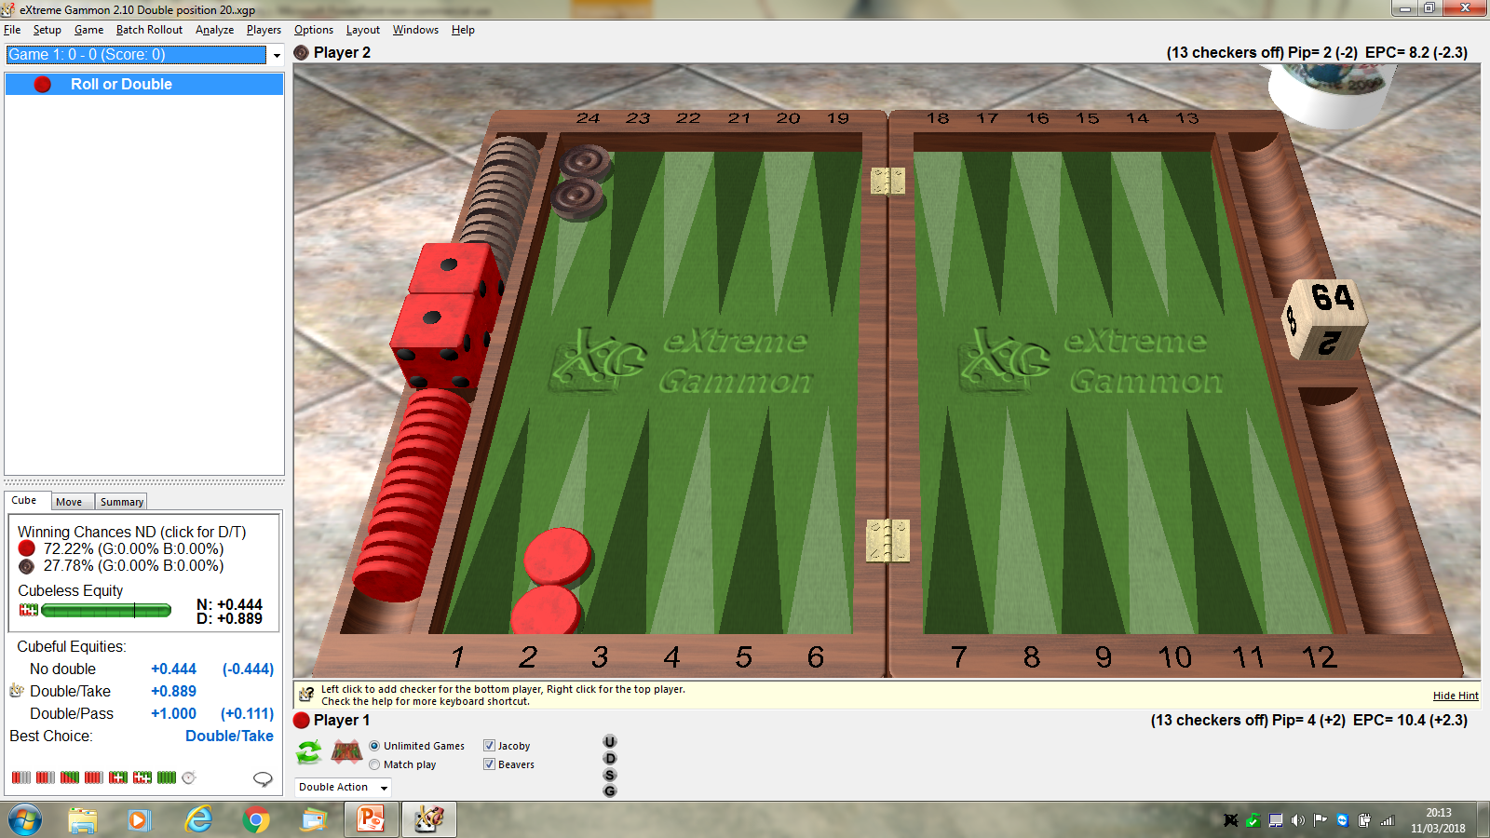

Slide 41
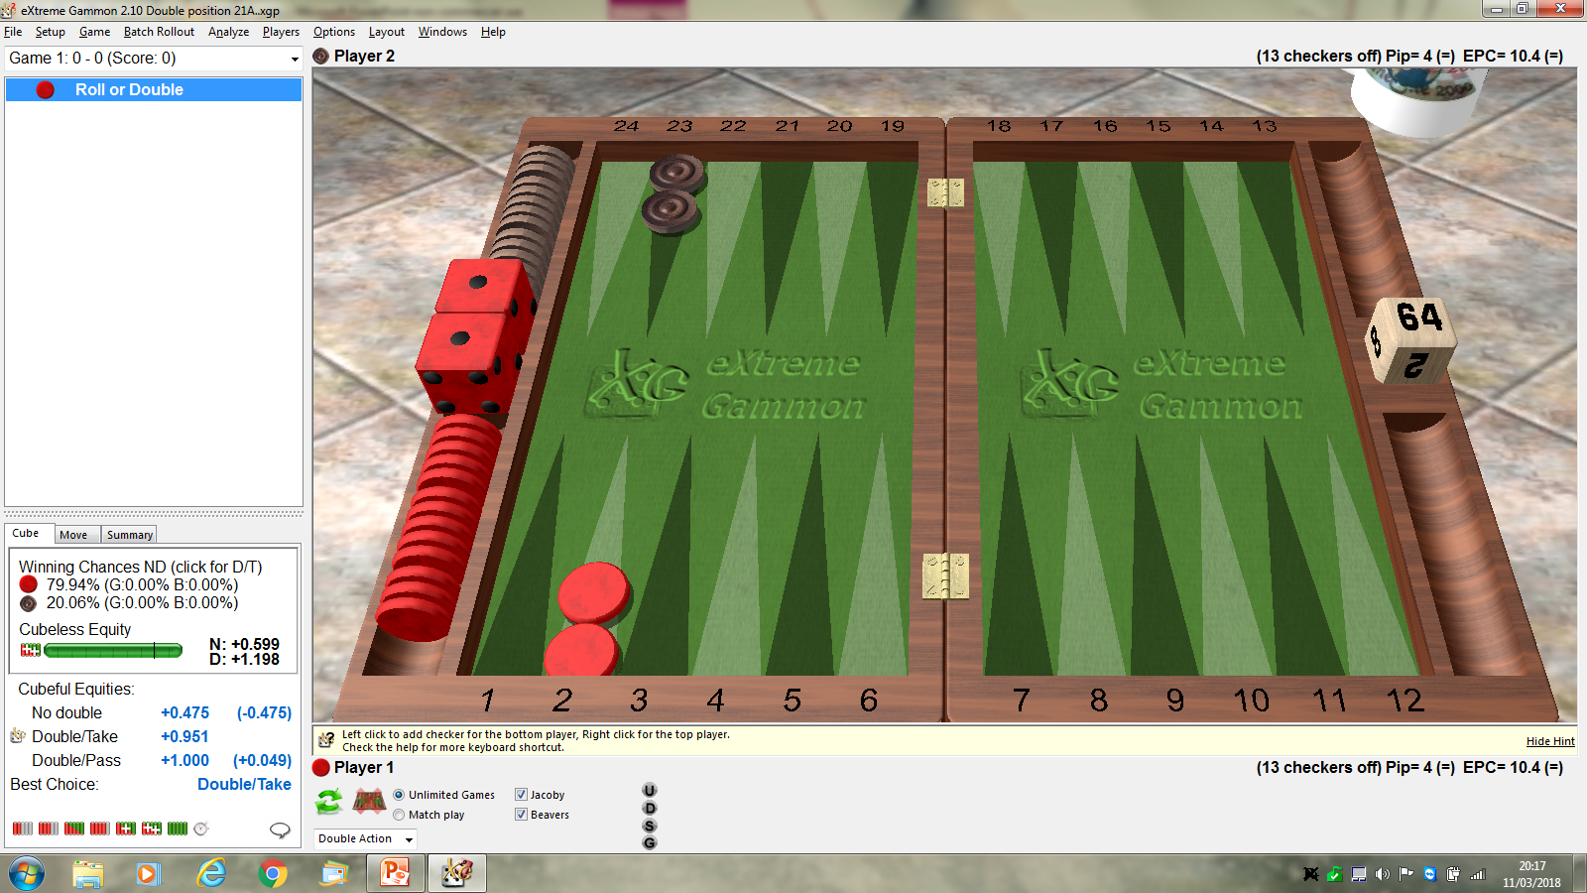

Slide 42


Slide 43
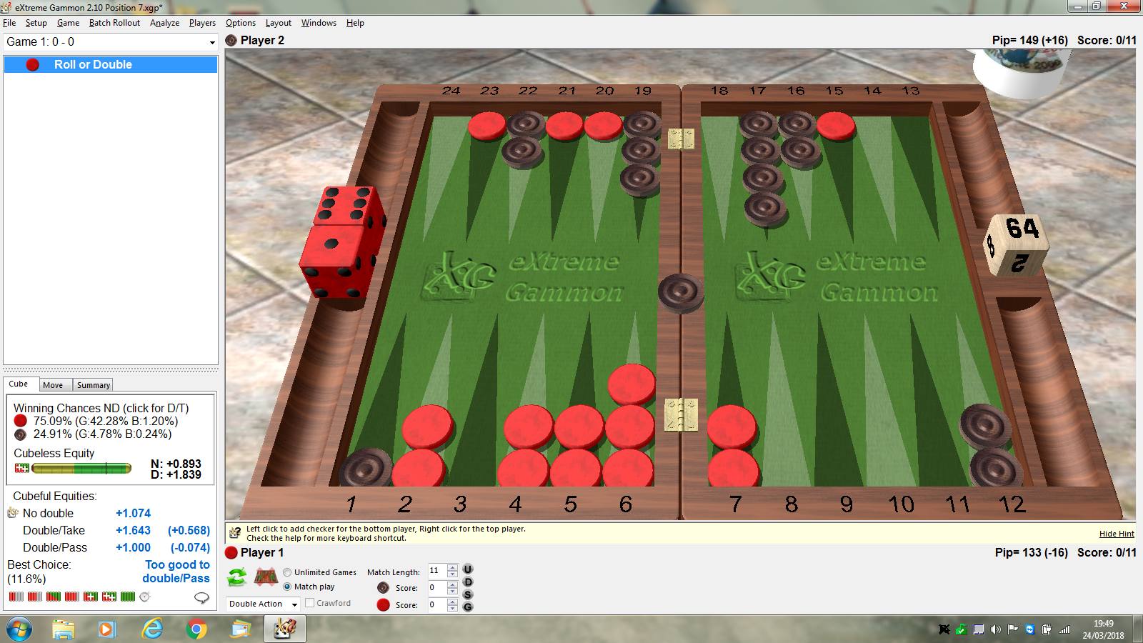

Slide 44
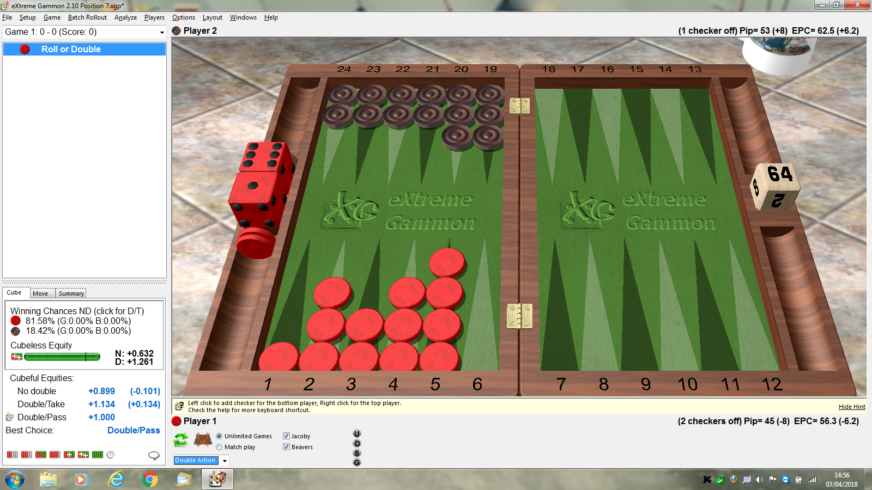

Slide 45
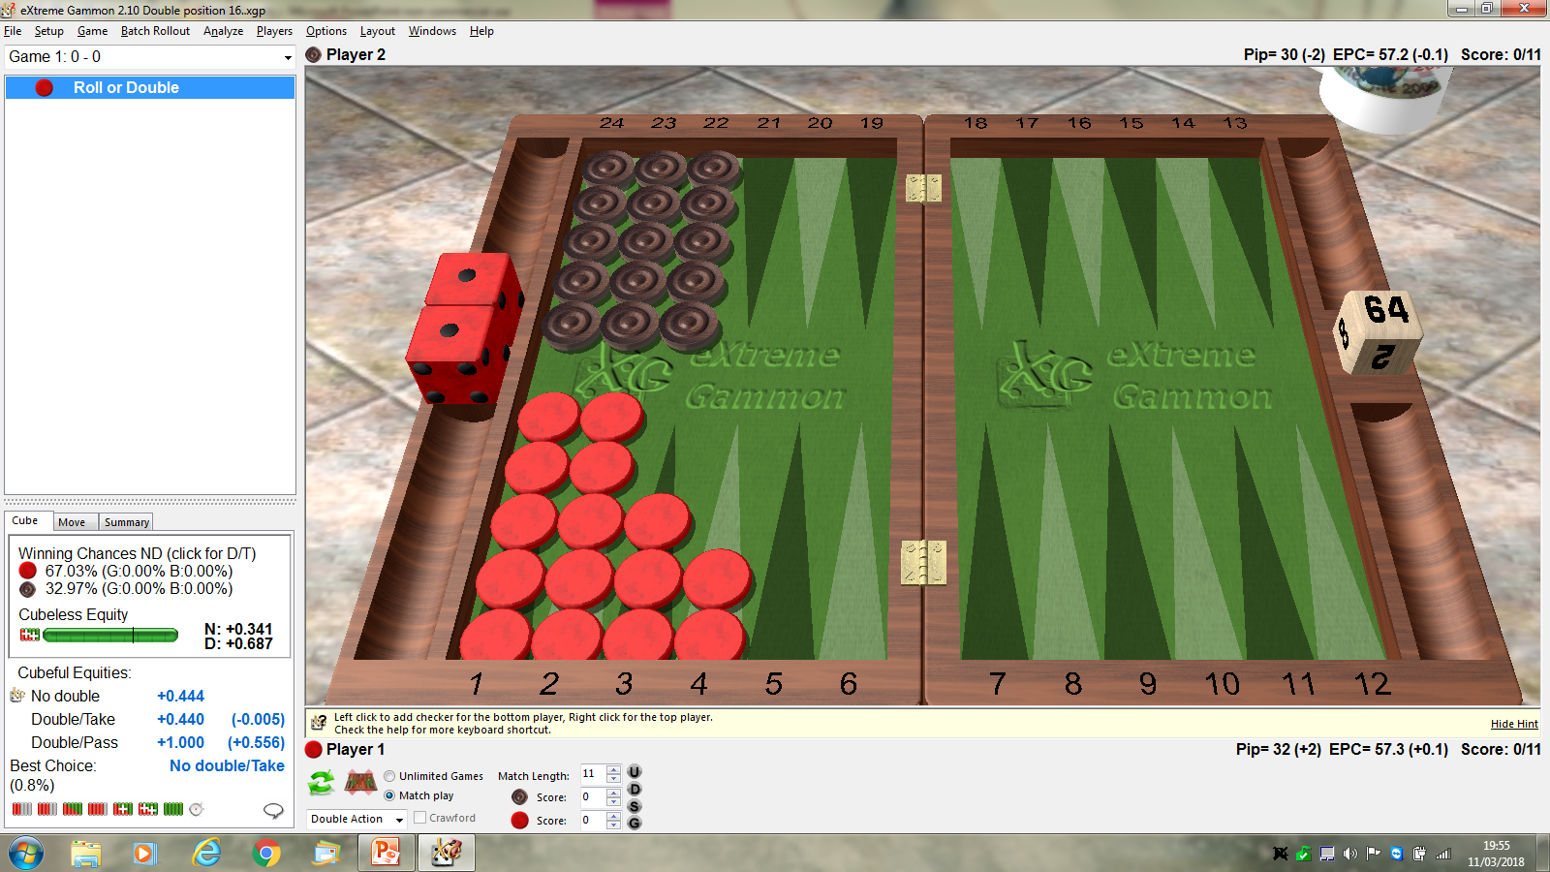

Slide 46
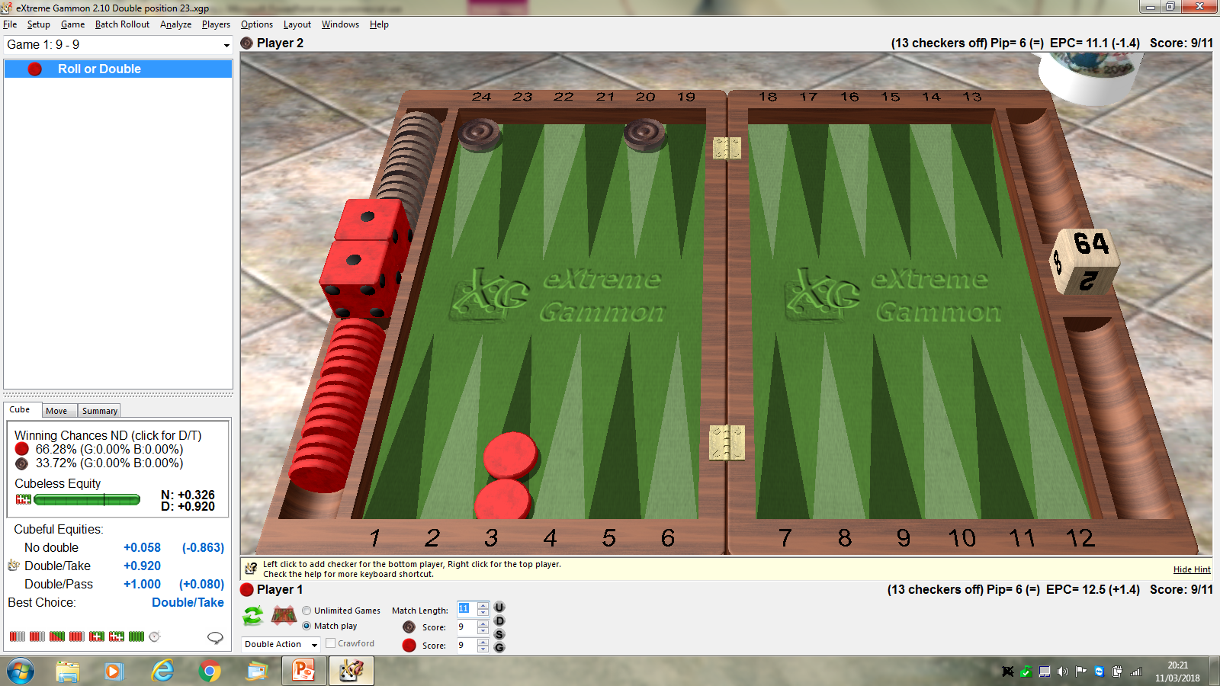

Slide 47
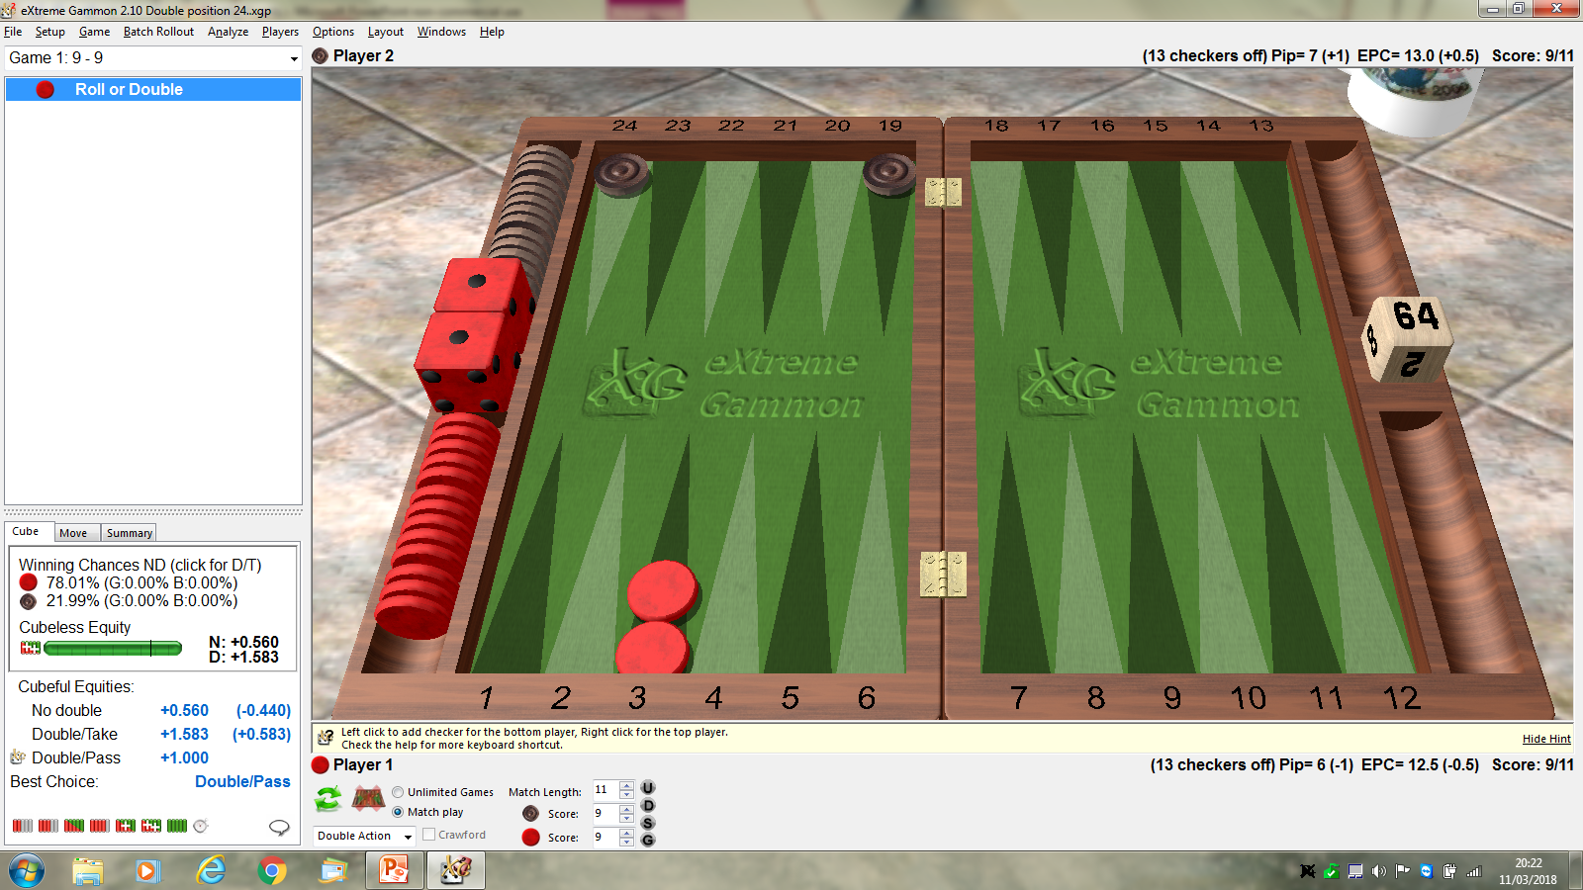

Slide 48


Slide 49
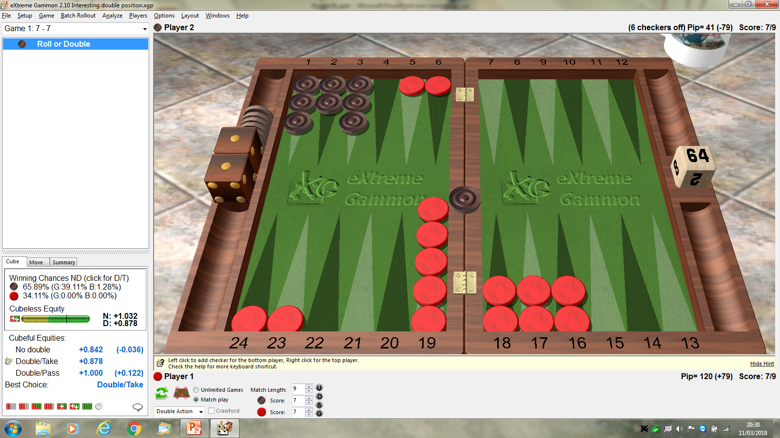

Slide 50
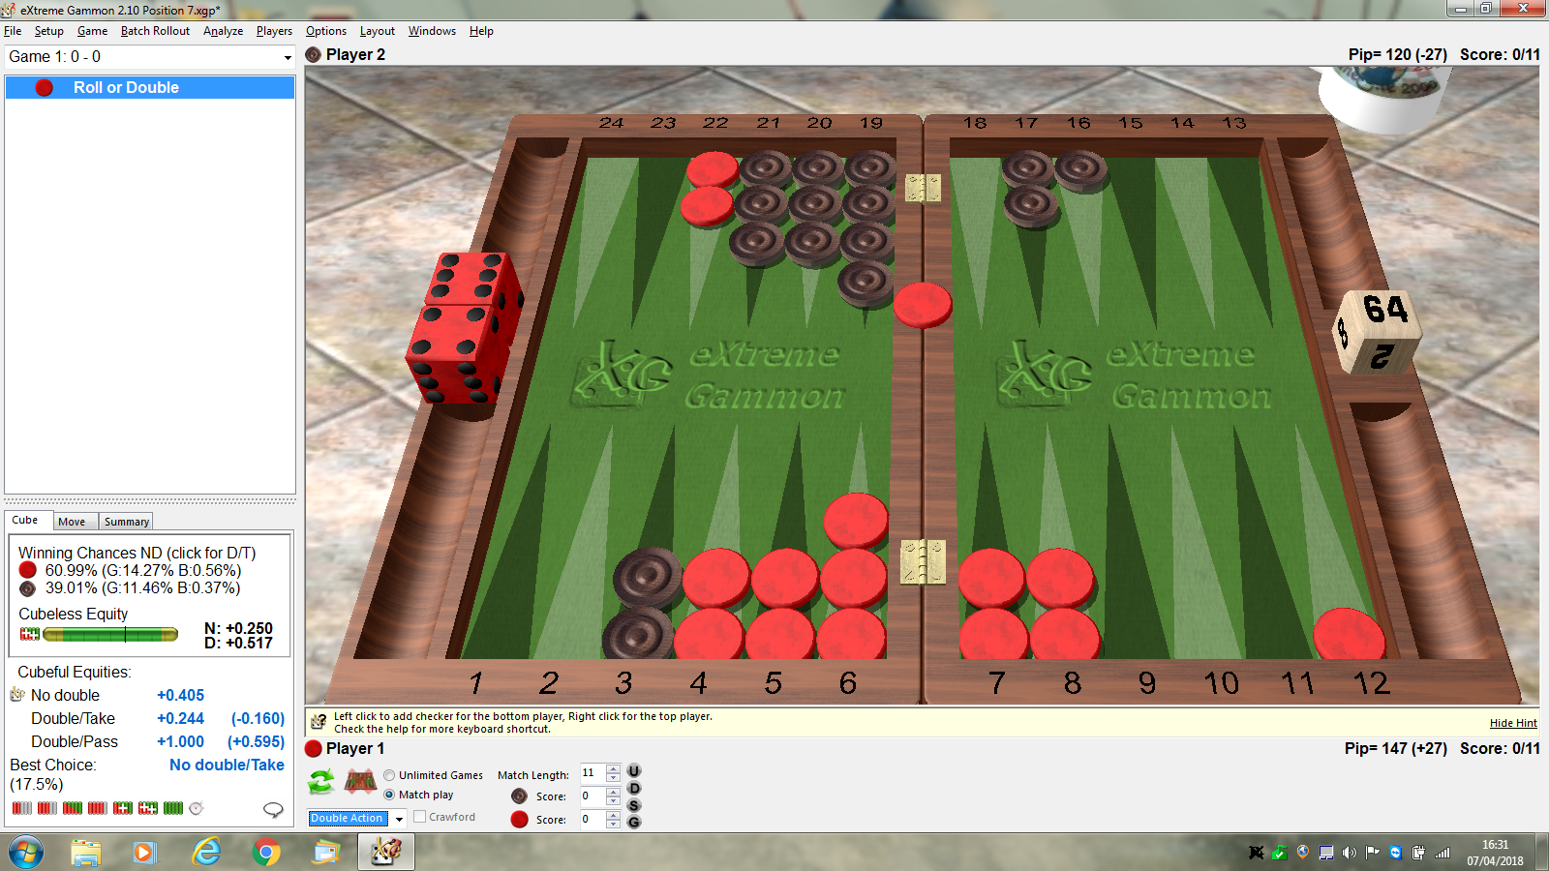

Slide 51
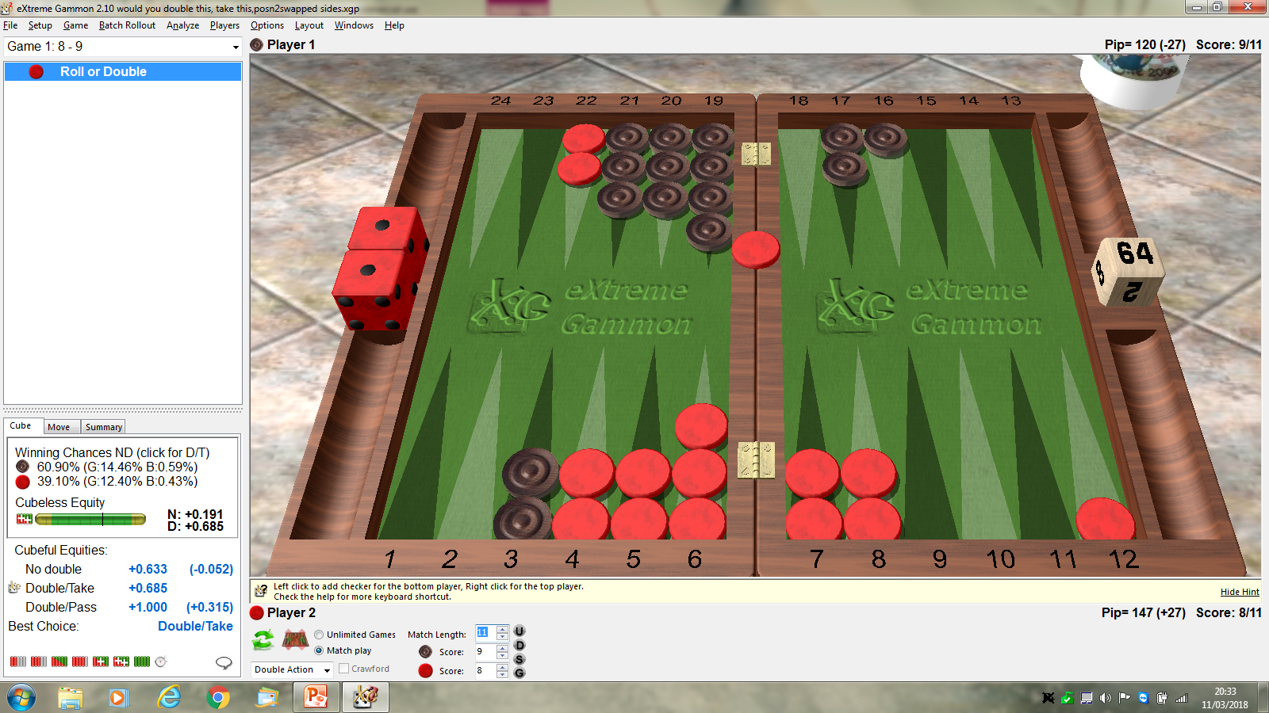

Slide 52
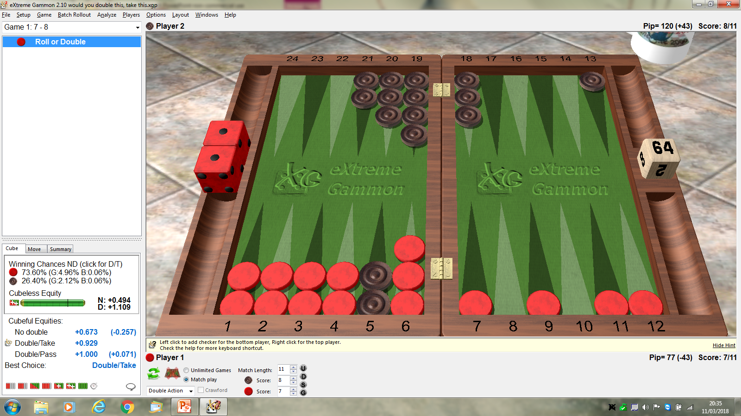

Slide 53
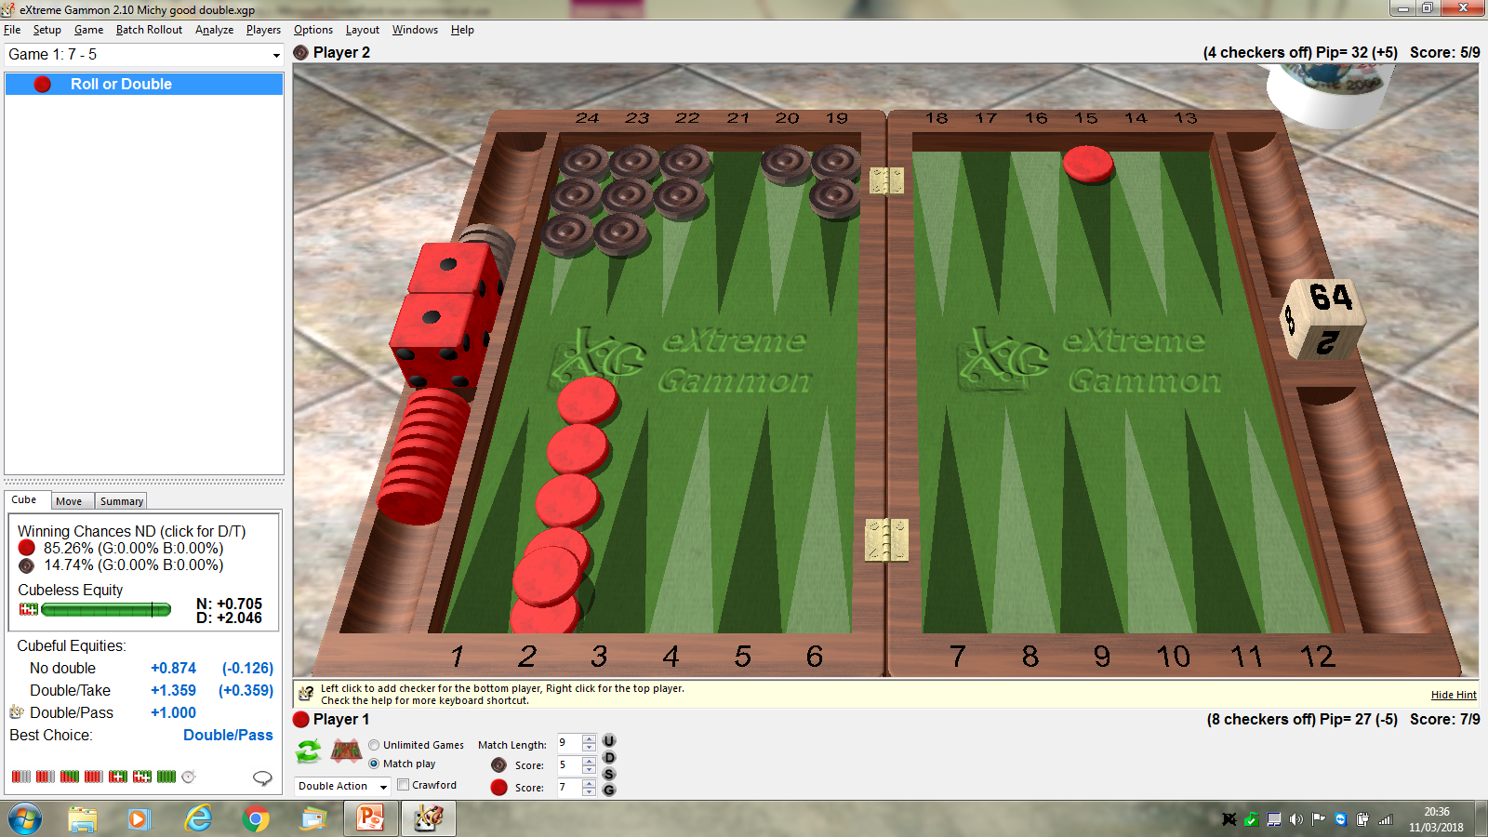

Slide 54
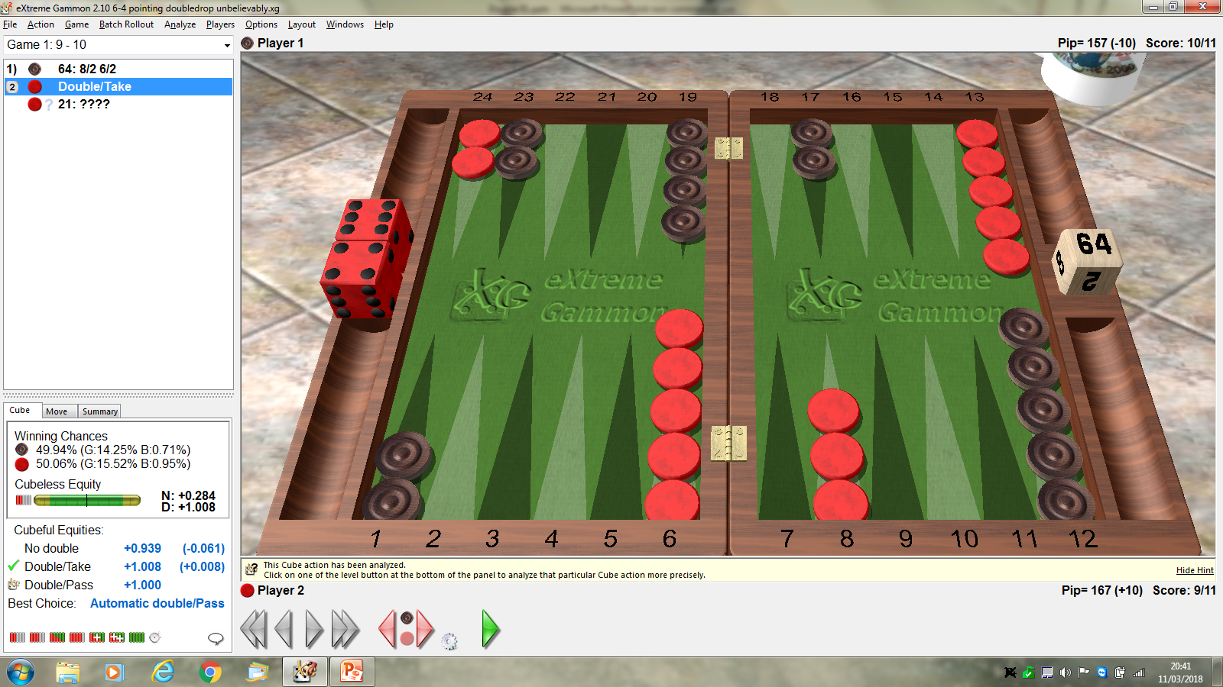

Slide 55
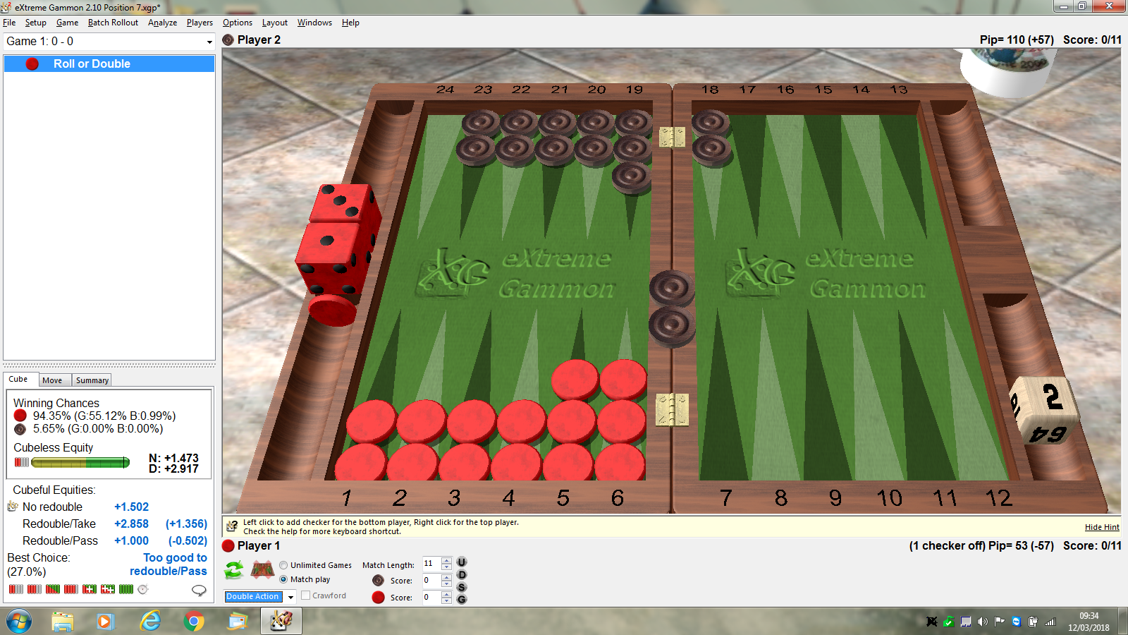

Slide 56
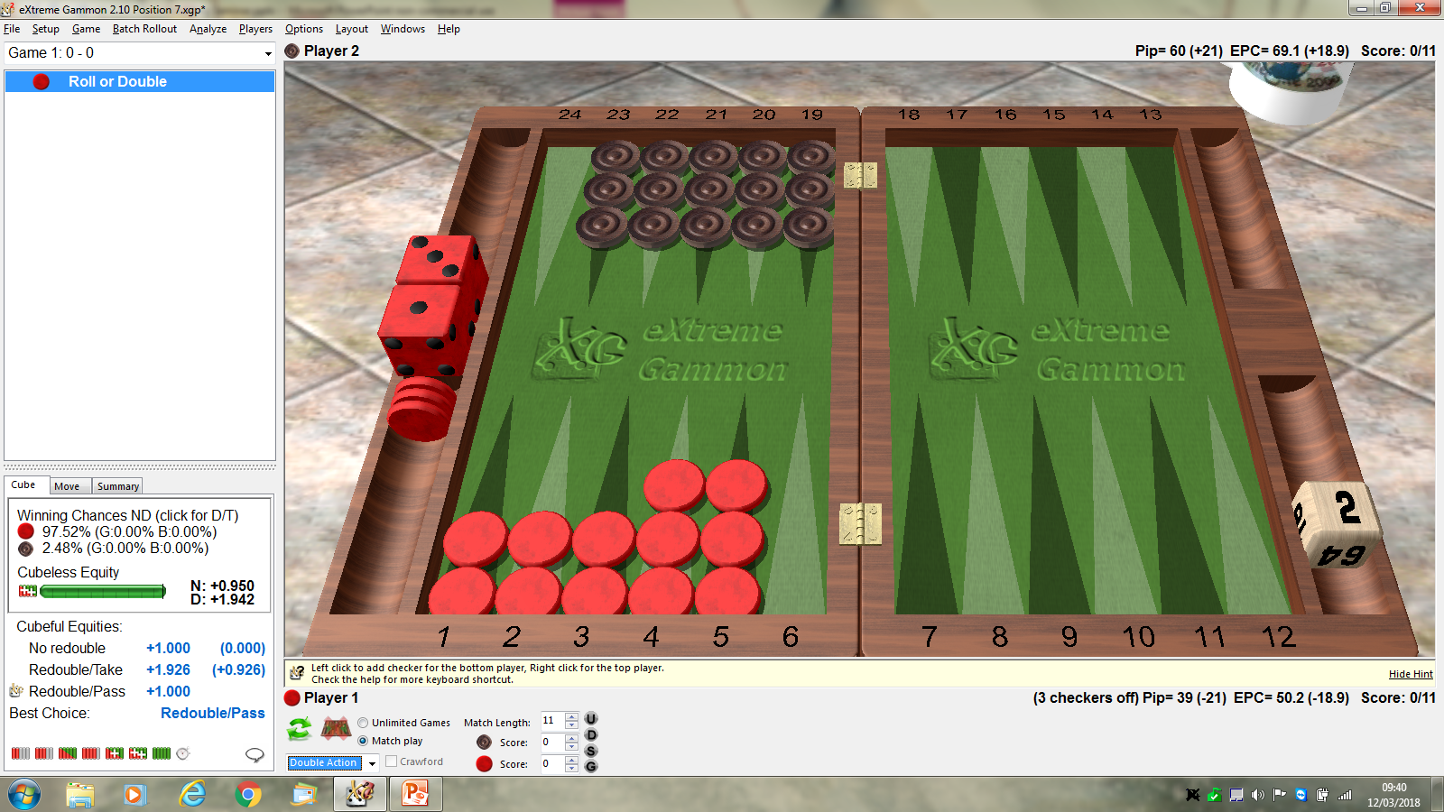

Slide 57
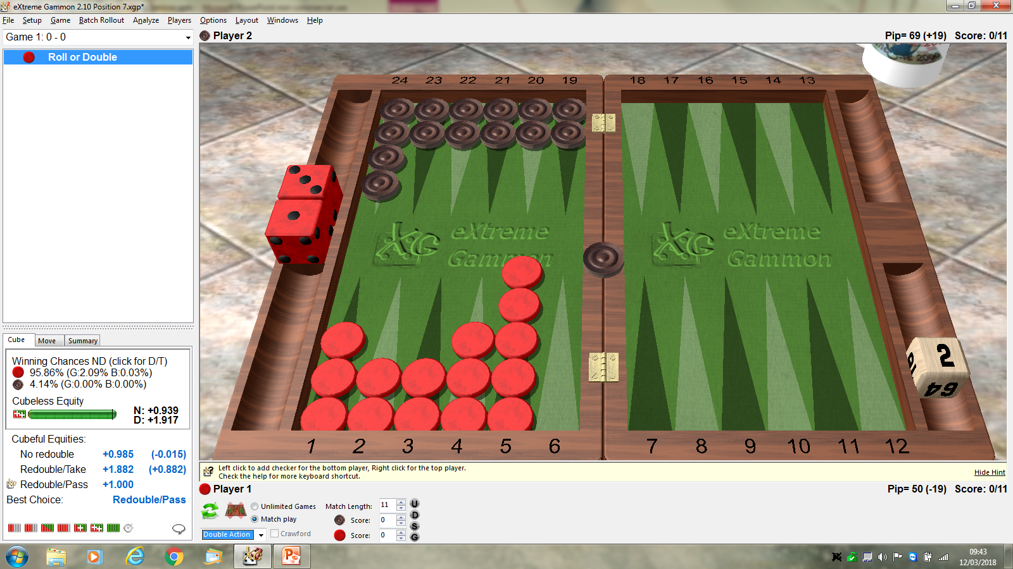

Slide 58
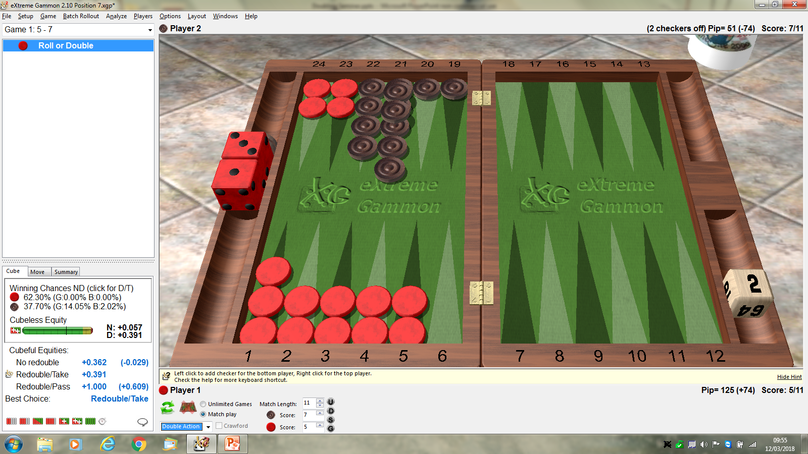

Slide 59


Slide 60
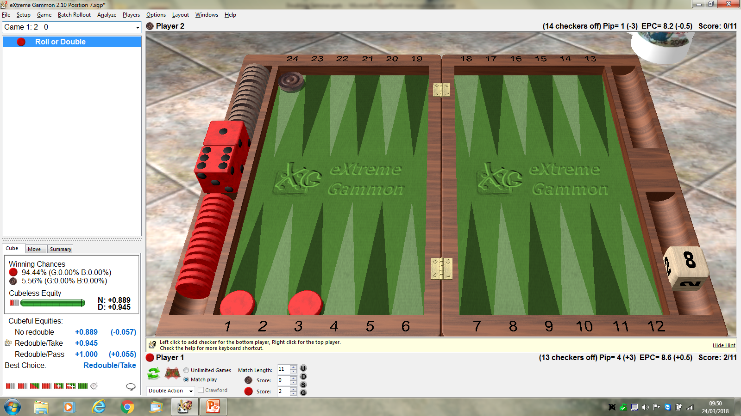

Slide 61
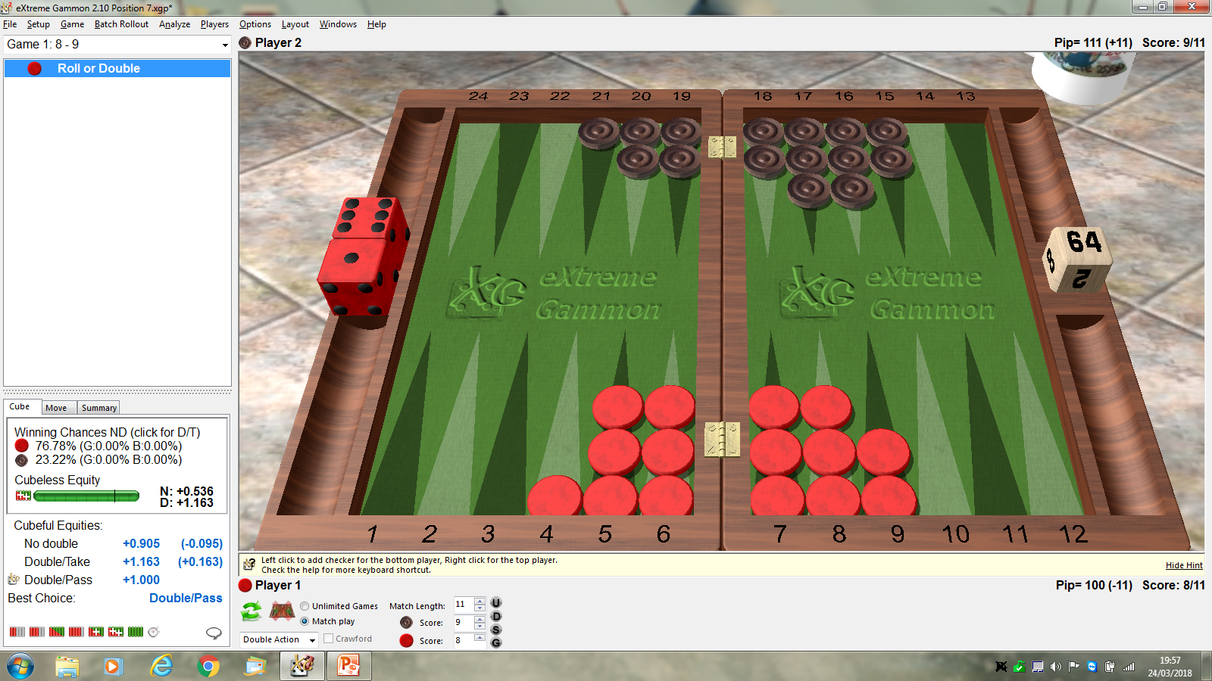

Slide 62
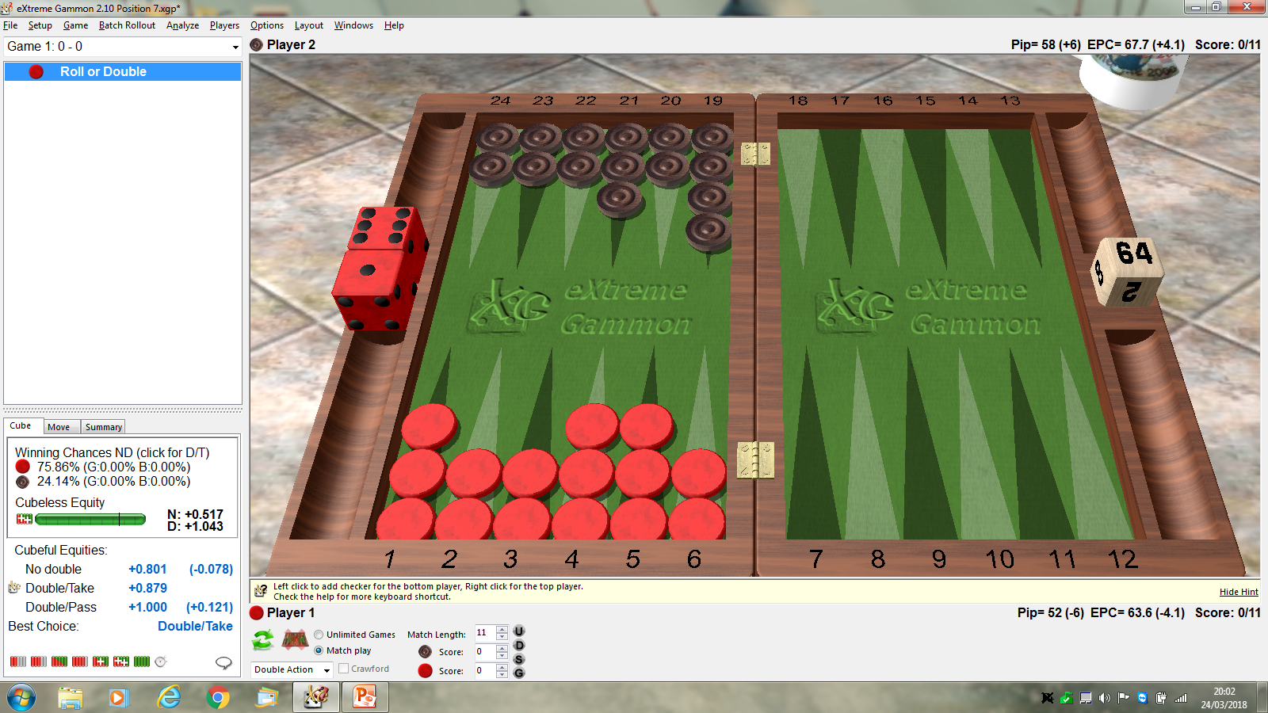

Slide 63


Slide 64
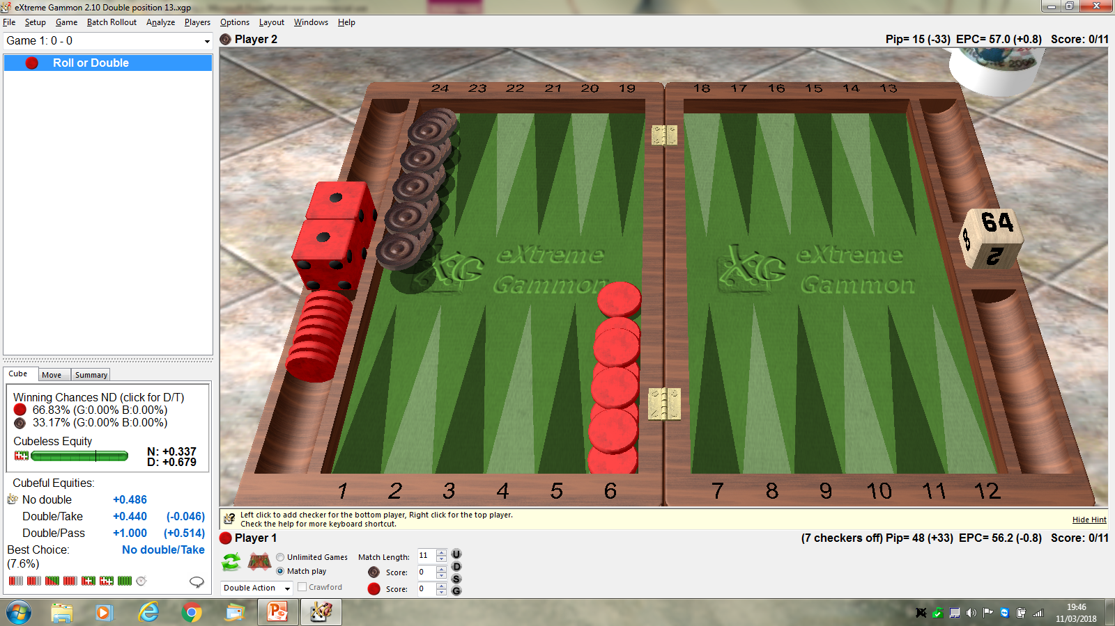

Slide 65
